Slide 1
NOUTATI IN HEMATOLOGIE
(N-I-H 2)
MIHAELA LAZAR, Medical Manager
19 aprilie 2016, SUUB

Slide 2

N-I-H
Obiectiv: Prezentare informatii stiintifice (noi)/interes, utile in practica clinica din Sectia Hematologie a SUUB si/sau pentru dezvoltarea profesionala a medicilor hematologi din SUUB.
Selectia informatiilor:
Subiecte de interes (F2F, emails): patologie, ghiduri terapeutice, molecule, investigatii, etc.
Reviste medicale internationale (hematologie)/sites (ex. PubMed, Cochrane Library)
Prezentare 20-30’ (SDZ / SDZ-Hematologie SUUB)
Discutii 30’
Feedback (feedback form).
mihaela.lazar@sandoz.com / medical.ro@sandoz.com

Slide 3
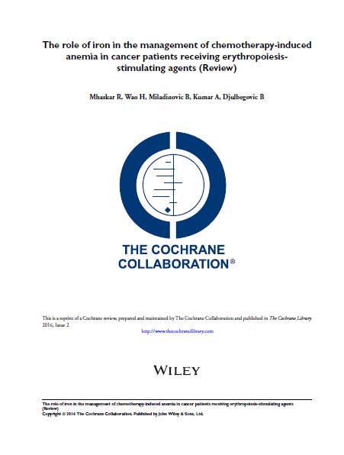

The role of iron in the management of
chemotherapy-induced
anemia in cancer patients receiving erythropoiesis stimulating agents
(Review)
http://onlinelibrary.wiley.com/enhanced/doi/10.1002/14651858.CD009624.pub2
Notes:
Majoritatea pacientilor cu cancer tratati cu chimioterapie dezvolta CIA.
~ 83% dintre pacienti tratati cu CT dezvolta CIA.
Majoritatea pacientilor cu CIA sufera de astenie, stare de slabiciune, dispnee → scaderea calitatii vietii si a statusului de performanta.
Obiectivul major al tratamentului in cazul pacientilor cu CIA este reducerea necesarului de trasnfuzii si maximizarea calitatii vietii.
Ghidurile NCCN si EORTC recomanda transfuziile de eritrocite ca o strategie eficienta de a trata CIA. Cu toate acestea, efectul transfuziilor este temporar si posibil asociat cu evenimente tromboembolice semnificative, precum si cu cresterea mortalitatii.
O alternativa la transfuziile de eritrocite in CIA este utilizarea ESAs.
ESAs cresc nivelurile de Hb, reduc necesarul de transfuzi si imbunatatesc calitatea vietii.
Cu toate acestea, si ESAs au aratat o incidenta mai mare a evenimentelor tromboembolice si cresterea mortalitatii (cu 10%).
Pacientii cu cancer care dezvolta CIA si care sunt tratati cu ESAs este foarte probabil sa experimenteze o crestere a necesarului de fier eritrocitar, care depaseste rezervele disponibile, avand ceea ce se numeste DEFICIT FUNCTIONAL DE FIER (FID = functional iron deficiency), cu producerea unor eritrocite sarace in fier la nivelul maduvei hematogene.
Co-administrarea de fier previne FID. Cu toate acestea, terapia cu fier nu este lipsita de neplaceri. Astfel, preparatele de fier administrate oral pot produce diaree/constipatie, inconfort stomacal, reactii alergice, etc. Cu toate acestea, preparatele de fier cu administrare intravenoasa se asociaza cu mai putine evenimente neplacute/adverse.
De-a lungul timpului au fost realizate cateva RTCs ca si-au propus sa evalueze eficacitatea asocierii fierului la ESAs vs. ESAs singuri pentru managementul CIA.
Cu toate acestea, evidentele referitoare la aceasta comparatie (Fe+ESAs vs ESAs) nu au fost pe deplin relevante. Unele studii au aratat ca asocierea de Fe iv la ESAs determina imbunatatirea raspunsului la ESAs, creste nivelul hb, raspuns hematopoietic mai mare, precum si imbunatatirea calitatii vietii pacientilor cu CIA. Alte studii arata ca Fe iv nu se asociaza cu modificari ale nivelurile Hb, transfuziilor sanguine si calitatii vietii pacientilor cu CIA.
Absenta unei evidente clare referitoare la beneficiile si riscurile asocierii Fierului la ESAs la pacientii cu CIA a fost punctul de plecare al acestei revizii sistematice.

Slide 4

Riscul de recurenta trombotica sub tratamentul cu epoetine,
Prezenta receptorilor de eritropoetina pe celulele canceroase,
Riscul de progresie a bolii neoplazice in caz de administrare de epoetine,
Gestionarea anemiei la un pacient oncologic care asociaza si patologie cardiaca semnificativa (daca sunt stabilite doze maxime/minime de epoetine care pot fi folosite la acesti pacienti),
Asocierea la tratamentul cu epoetine a unor doze reduse de factori de crestere granulocitari, care ar potenta efectul si raspunsul epoetinelor.

Slide 5
Riscul de recurenta trombotica sub tratamentul cu epoetine,
Prezenta receptorilor de eritropoetina pe celulele canceroase,
Riscul de progresie a bolii neoplazice in caz de administrare de epoetine,
Gestionarea anemiei la un pacient oncologic care asociaza si patologie cardiaca semnificativa (daca sunt stabilite doze maxime/minime de epoetine care pot fi folosite la acesti pacienti),
Asocierea la tratamentul cu epoetine a unor doze reduse de factori de crestere granulocitari, care ar potenta efectul si raspunsul epoetinelor.

Slide 6
Venous thrombosis is a common complication in patients with cancer, leading to additional morbidity and compromising quality of life.
  Thrombosis is the second most common cause of death in cancer patients.
  Compared with patients who do not have cancer, oncology patients are at substantially higher risk for new and recurrent VTE.
  Patients with hematological malignancies had the highest risk of venous thrombosis, followed by lung cancer and gastrointestinal cancer.
Venous thromboembolism (VTE) in cancer is also associated with a high rate of recurrence, bleeding, a requirement for long-term anticoagulation, and worsened quality of life.
Khorana A. A., Annals of Oncology 20: 1619–1630,2009; Blom J., JAMA. 2005;293:715-722
Notes:
Venous thromboembolism (VTE), which includes both deep vein thrombosis (DVT) and pulmonary embolism (PE), is the second leading cause of death in hospitalized and ambulatory cancer patients [1–3]. Compared with patients who do not have cancer, oncology patients are at substantially higher risk for new and recurrent VTE [4–7]. The risk of VTE in cancer patients is particularly increased for those who are undergoing surgery (three- to fivefold) [2], those who are receiving chemotherapy (6.5-fold) [6], those who carry certain genetic mutations [8], and those with previous DVT [9]. The increased risk of recurrent VTE in cancer patients is greatest in the first few months after malignancy is diagnosed [8] and can persist for many years after an initial episode of symptomatic DVT [9].
VTE may itself be a sign of occult malignancy [10, 11]. In a series of patients hospitalized for bilateral DVT, 25% were known to have cancer at admission, and new cancer was diagnosed in 26% of those without known cancer at admission [10]
Tromboembolismul venos (TEV) este o boală frecventă, adesea nediagnosticată, asociată cu o importantă morbiditate şi mortalitate. Tromboza venoasă profundă (TVP) şi embolia pulmonară (EP) sunt cele două manifestări ale aceleiaşi boli, definită în prezent ca TEV.

Slide 7
Risk factors for cancer-associated VTE include particular cancer types, chemotherapy, the use of erythropoietin stimulating agents, the presence of central venous catheters, and surgery. Novel risk factors include platelet and leukocyte counts and tissue factor.
The increased risk of recurrent VTE in cancer patients is greatest in the first few months after malignancy is diagnosed and can persist for many years after an initial episode of symptomatic DVT.
Patients with cancer with distant metastases have a higher risk vs patients without distant metastases.
Khorana A. A., Annals of Oncology 20: 1619–1630,2009; Blom J., JAMA. 2005;293:715-722
Notes:
The risk of VTE in cancer patients is particularly increased for those who are undergoing surgery (three- to fivefold) [2], those who are receiving chemotherapy (6.5-fold) [6], those who carry certain genetic mutations [8], and those with previous DVT [9].

Slide 8
Potential risk factors for VTE can be divided into patient-, cancer-, and treatment-related characteristics.
Patient related factors include:
  advanced age, female sex, black ethnicity, comorbid conditions, and prothrombotic mutations.
Tumor related factors relate to the site, stage, and duration of cancer.
Treatment-related factors include:
  pharmacologic agents [e.g. chemotherapeutic agents, hormonal agents, antiangiogenic agents, and erythropoiesis-stimulating agents (ESAs) and
  mechanical causes, e.g. surgery and central venous catheters (CVCs)].
Khorana A. A., Annals of Oncology 20: 1619–1630, 2009
Notes:
Venous thromboembolism (VTE), which includes both deep vein thrombosis (DVT) and pulmonary embolism (PE), is the second leading cause of death in hospitalized and ambulatory cancer patients [1–3]. Compared with patients who do not have cancer, oncology patients are at substantially higher risk for new and recurrent VTE [4–7]. The risk of VTE in cancer patients is particularly increased for those who are undergoing surgery (three- to fivefold) [2], those who are receiving chemotherapy (6.5-fold) [6], those who carry certain genetic mutations [8], and those with previous DVT [9]. The increased risk of recurrent VTE in cancer patients is greatest in the first few months after malignancy is diagnosed [8] and can persist for many years after an initial episode of symptomatic DVT [9].
VTE may itself be a sign of occult malignancy [10, 11]. In a series of patients hospitalized for bilateral DVT, 25% were known to have cancer at admission, and new cancer was diagnosed in 26% of those without known cancer at admission [10]

Slide 9
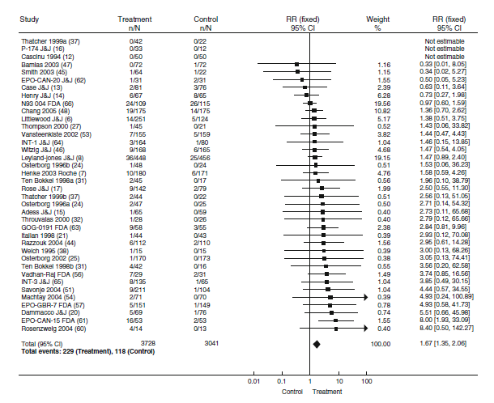
Several meta-analyses have been carried out on randomized trials of ESAs in patients with cancer.
Overall, in these pooled analyses including patients with a wide variety of cancers and baseline thrombosis risk, there is an observed increase in the incidence of thrombosis associated with ESA therapy, with an estimated relative risk of approximately 1.6.
Nowrousian M., Recombinant Human Erythropoietin (rhEPO) in Clinical Oncology , 2nd edition, 2010
Notes:
This reflects an absolute risk increase of 2-3%, from 3-4% to 5-6%.
This appears to be a class effect, with similar risks observed with recombinant erythropoietins and with darbepoetin alfa (Ross et al. 2006).

Slide 10
The majority of these thrombotic events are venous thromboses, catheter-associated clots and pulmonary emboli.
ESA therapy has not been linked to an increase in arterial events, such as cerebrovascular accidents and myocardial infarctions, in cancer patients.
Nowrousian M., Recombinant Human Erythropoietin (rhEPO) in Clinical Oncology , 2nd edition, 2010
Notes:
This reflects an absolute risk increase of 2-3%, from 3-4% to 5-6%.

Slide 11
Khorana AA, Kuderer NM, Culakova E, Lyman GH, Francis CW
Development and Validation of a
Predictive Model for
Chemotherapy-associated Thrombosis
Blood 2008

Slide 12
Risk Factors for Chemotherapy-associated VTE
Patient Characteristic | Risk Score
Site of cancer: stomach, pancreas | 2
Site of cancer: lung, lymphoma, gynaecologic, bladder, testicular | 1
Platelet count > 350,000/mm³ | 1
Haemoglobin < 10 g/dl or use of erythropoietin | 1
Leukocyte count > 11,000/ mm³ | 1
Body mass index > 35 | 1
Low risk: score 0
Intermediate risk: score 1-2
High risk: score ≥ 3
Adapted from Khorana et al. Blood 2008.

Slide 13
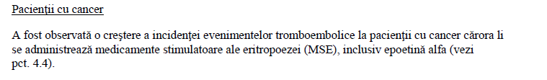
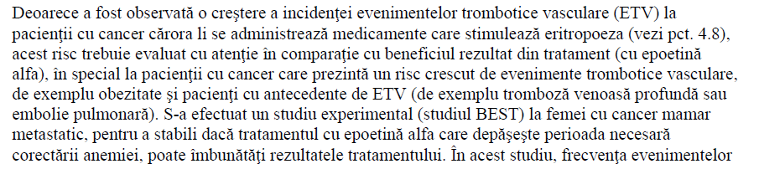
Binocrit, Rezumatul Caracterisiticilor Produsului.

Slide 14
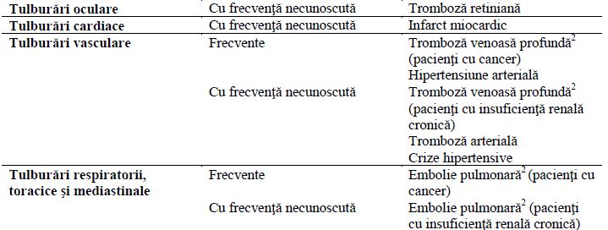
Binocrit, Rezumatul Caracterisiticilor Produsului.

Slide 15

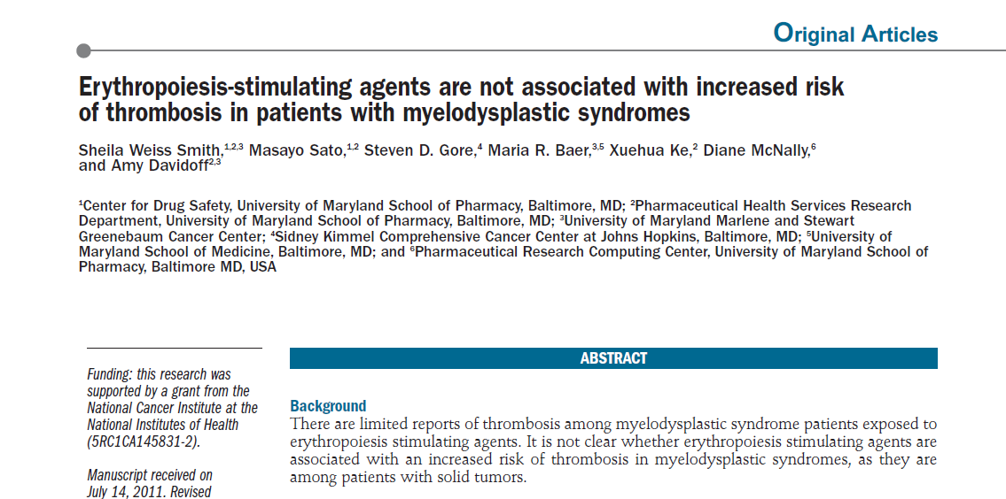

Notes:
This reflects an absolute risk increase of 2-3%, from 3-4% to 5-6%.

Slide 16
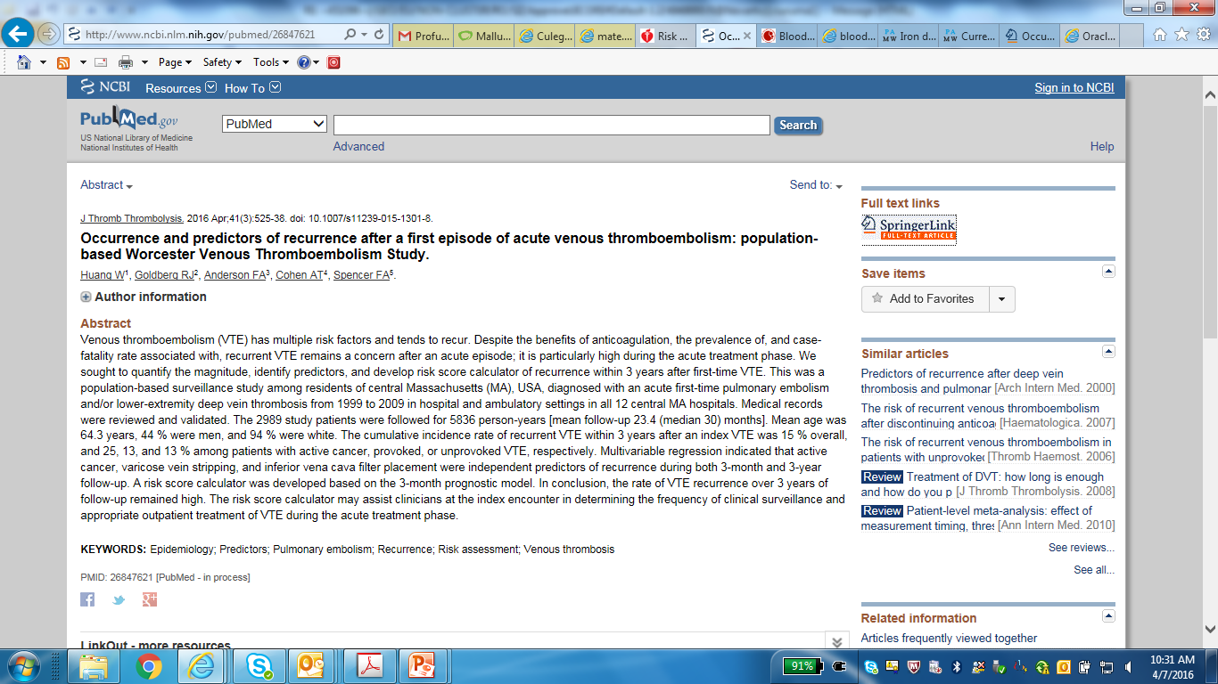
Notes:
ArticleJournal of Thrombosis and Thrombolysis
April 2016, Volume 41, Issue 3, pp 525-538
First online: 05 February 2016
Occurrence and predictors of recurrence after a first episode of acute venous thromboembolism: population-based Worcester Venous Thromboembolism Study
Wei HuangAffiliated withDepartment of Surgery, Center for Outcomes Research, University of Massachusetts Medical School Email author
, Robert J. GoldbergAffiliated withDepartment of Quantitative Health Science, University of Massachusetts Medical School
, Frederick A. AndersonAffiliated withDepartment of Surgery, Center for Outcomes Research, University of Massachusetts Medical School
, Alexander T. CohenAffiliated withHaematological Medicine, Guy’s and St Thomas’ Hospitals, King’s College
, Frederick A. SpencerAffiliated withDepartment of Medicine, McMaster University
Abstract
Venous thromboembolism (VTE) has multiple risk factors and tends to recur. Despite the benefits of anticoagulation, the prevalence of, and case-fatality rate associated with, recurrent VTE remains a concern after an acute episode; it is particularly high during the acute treatment phase. We sought to quantify the magnitude, identify predictors, and develop risk score calculator of recurrence within 3 years after first-time VTE. This was a population-based surveillance study among residents of central Massachusetts (MA), USA, diagnosed with an acute first-time pulmonary embolism and/or lower-extremity deep vein thrombosis from 1999 to 2009 in hospital and ambulatory settings in all 12 central MA hospitals. Medical records were reviewed and validated. The 2989 study patients were followed for 5836 person-years [mean follow-up 23.4 (median 30) months]. Mean age was 64.3 years, 44 % were men, and 94 % were white. The cumulative incidence rate of recurrent VTE within 3 years after an index VTE was 15 % overall, and 25, 13, and 13 % among patients with active cancer, provoked, or unprovoked VTE, respectively. Multivariable regression indicated that active cancer, varicose vein stripping, and inferior vena cava filter placement were independent predictors of recurrence during both 3-month and 3-year follow-up. A risk score calculator was developed based on the 3-month prognostic model. In conclusion, the rate of VTE recurrence over 3 years of follow-up remained high. The risk score calculator may assist clinicians at the index encounter in determining the frequency of clinical surveillance and appropriate outpatient treatment of VTE during the acute treatment phase.

Slide 17
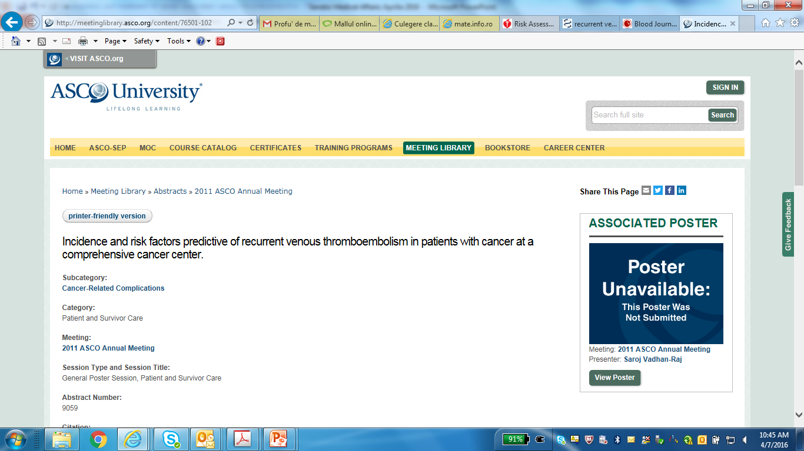
Notes:
Abstract:
Background: Patients (pts) with cancer and venous thromboembolism (VTE) are at high risk for recurrence of VTE. However, the exact incidence and risk factors are not well-known for recurrence. Methods: Medical records of all pts with VTE, confirmed by radiological studies, during one year period (2006) were reviewed for the type of VTE, the incidence of recurrence during one-year from the primary event, and the baseline risk factors for recurrent VTE, including demographics, history of VTE, erythropoiesis-stimulating agents, transfusions, blood counts, BUN/creatinine, and D-dimer. Univariate and multivariate Cox models were built to identify the risk factors for recurrent VTE. Results: 1215 episodes of VTE were diagnosed in 980 patients (532 males and 448 females); 480 DVT, 478 PE, and 22 DVT and PE. 138 of 980 pts (14.1%) had recurrent VTE during 1 year; majority of pts (99 pts, 72%) had recurrence during 3 months. We, therefore, examined risk factors for recurrence during 3 months. The recurrence rate for pts < 60 years was 13.0% (60/461) as compared to 7.5% (39/519) for those >60 years, p=0.0043. Pts with PE had higher recurrence rate than pts with DVT [12.4% (62/500) vs. 7.7% (37/480), p=0.015]. Pts with HGB >12 g/dL had higher recurrence rate than pts with < 12g/dL [13.5% (39/289) vs. 8.7% (60/691), p=0.023]. Pts with PLT counts < 25 k/uL had lower recurrence than those with > 25k/uL [3.2% (3/93) vs. 10.8% (96/887), p=0.021]. Men had higher recurrence than women [11.7% (62/532) vs. 8.3% (37/448), p=0.079]. Multivariate analysis showed that younger pts [<60 vs > 60 years, hazard ratio (HR):2.08, 95%CI: 1.36-3.19, p=0.0007), pts with PE [PE vs DVT, HR 1.82(1.18-2.81), p=0.0071], and male gender [male vs female, HR 1.56(1.02-2.40), p=0.041] were independent risk factors predictive of recurrence. Conclusions: Incidence of VTE recurrence is high among cancer pts, especially during first 3 months. Male pts, younger (<60 years) pts, and pts with PE were at significantly higher risk for recurrent VTE and may help identify high risk patients for prevention strategy for recurrence.

Slide 18
Abstract:
Background: Patients (pts) with cancer and venous thromboembolism (VTE) are at high risk for recurrence of VTE. However, the exact incidence and risk factors are not well-known for recurrence.
Methods: Medical records of all pts with VTE, confirmed by radiological studies, during one year period (2006) were reviewed for the type of VTE, the incidence of recurrence during one-year from the primary event, and the baseline risk factors for recurrent VTE, including demographics, history of VTE, erythropoiesis-stimulating agents, transfusions, blood counts, BUN/creatinine, and D-dimer. Univariate and multivariate Cox models were built to identify the risk factors for recurrent VTE.
Results: 1215 episodes of VTE were diagnosed in 980 patients (532 males and 448 females); 480 DVT, 478 PE, and 22 DVT and PE. 138 of 980 pts (14.1%) had recurrent VTE during 1 year; majority of pts (99 pts, 72%) had recurrence during 3 months. We, therefore, examined risk factors for recurrence during 3 months. The recurrence rate for pts < 60 years was 13.0% (60/461) as compared to 7.5% (39/519) for those >60 years, p=0.0043. Pts with PE had higher recurrence rate than pts with DVT [12.4% (62/500) vs. 7.7% (37/480), p=0.015]. Pts with HGB >12 g/dL had higher recurrence rate than pts with < 12g/dL [13.5% (39/289) vs. 8.7% (60/691), p=0.023]. Pts with PLT counts < 25 k/uL had lower recurrence than those with > 25k/uL [3.2% (3/93) vs. 10.8% (96/887), p=0.021]. Men had higher recurrence than women [11.7% (62/532) vs. 8.3% (37/448), p=0.079]. Multivariate analysis showed that younger pts [<60 vs > 60 years, hazard ratio (HR):2.08, 95%CI: 1.36-3.19, p=0.0007), pts with PE [PE vs DVT, HR 1.82(1.18-2.81), p=0.0071], and male gender [male vs female, HR 1.56(1.02-2.40), p=0.041] were independent risk factors predictive of recurrence.
Conclusions: Incidence of VTE recurrence is high among cancer pts, especially during first 3 months. Male pts, younger (<60 years) pts, and pts with PE were at significantly higher risk for recurrent VTE and may help identify high risk patients for prevention strategy for recurrence.
Notes:
This reflects an absolute risk increase of 2-3%, from 3-4% to 5-6%.

Slide 19
Riscul de recurenta trombotica sub tratamentul cu epoetine,
Prezenta receptorilor de eritropoetina pe celulele canceroase,
Riscul de progresie a bolii neoplazice in caz de administrare de epoetine,
Gestionarea anemiei la un pacient oncologic care asociaza si patologie cardiaca semnificativa (daca sunt stabilite doze maxime/minime de epoetine care pot fi folosite la acesti pacienti),
Asocierea la tratamentul cu epoetine a unor doze reduse de factori de crestere granulocitari, care ar potenta efectul si raspunsul epoetinelor.

Slide 20
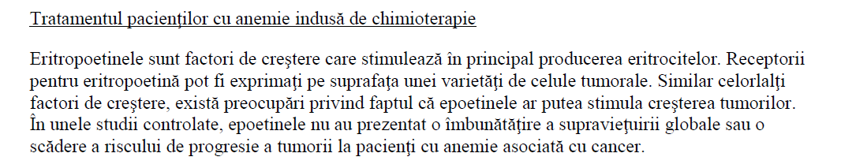
Binocrit, Rezumatul Caracteristicilor Produsului, martie 2016

Slide 21
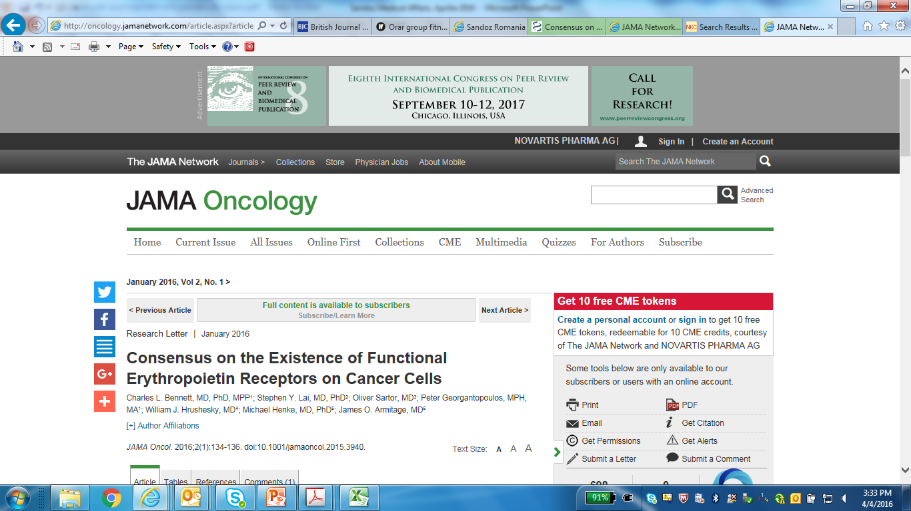
Notes:
JAMA – Journal of the American Medical Association
Extract
Academic scientists and scientists employed by manufacturers of erythropoiesis-stimulating agents report opposite findings in studies of the existence of functional erythropoietin receptors on cancer cells.
Even when the US Food and Drug Administration approved erythropoietin to treat chemotherapy-induced anemia in 1993, concern was raised that administration of erythropoietin may lead to tumor growth. This possibility was derived from concern that erythropoietin receptors or homologous receptors reside on cancer cells and respond to exogenous erythropoietin, inducing activation of the cell signaling pathway and cellular functional changes. There has been widespread disagreement on this topic. Before 2008, a review found that scientists without funding from manufacturers of erythropoiesis-stimulating agents (ESAs) were more likely than scientists with such funding or scientists employed by manufacturers of ESAs to report erythropoietin receptors on solid tumor cells, erythropoietin-induced signaling changes, or cellular function changes.1 Three studies have been published by scientists employed by manufacturers of ESAs, which was too small a number to allow for direct comparisons between findings of academic scientists and scientists employed by manufacturers of ESAs.1 In 2007, the National Cancer Institute convened a workshop seeking to facilitate consensus on this topic. Thirteen of 14 academic scientists without funding from manufacturers of ESAs reported that erythropoietin receptors were involved in cancer progression while all 6 scientists employed by manufacturers of ESAs reported the opposite (A. Mufson, PhD, written communication, August 2015) (Table). Review of subsequent studies provides opportunities to evaluate whether consensus was achieved after the workshop. Our hypothesis is that differences in findings regarding erythropoietin receptors between academic scientists and scientists employed by manufacturers of ESAs would persist after the workshop.

Slide 22
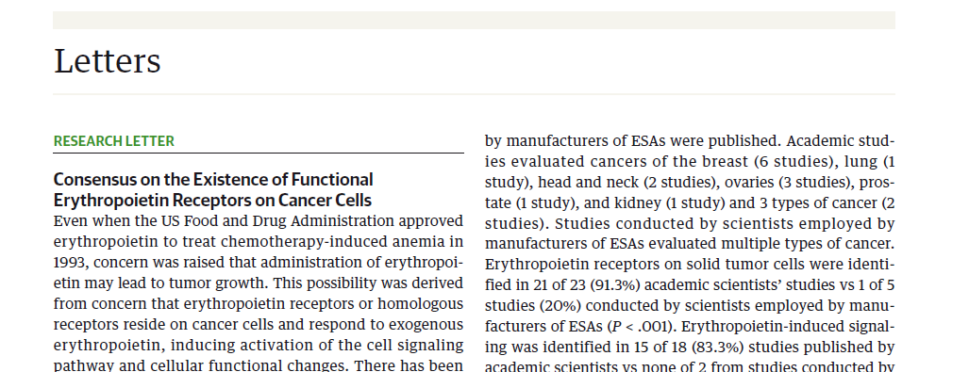
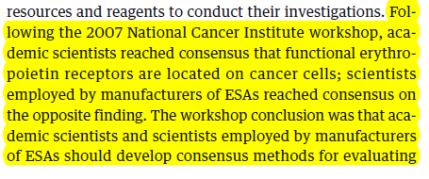


Slide 23
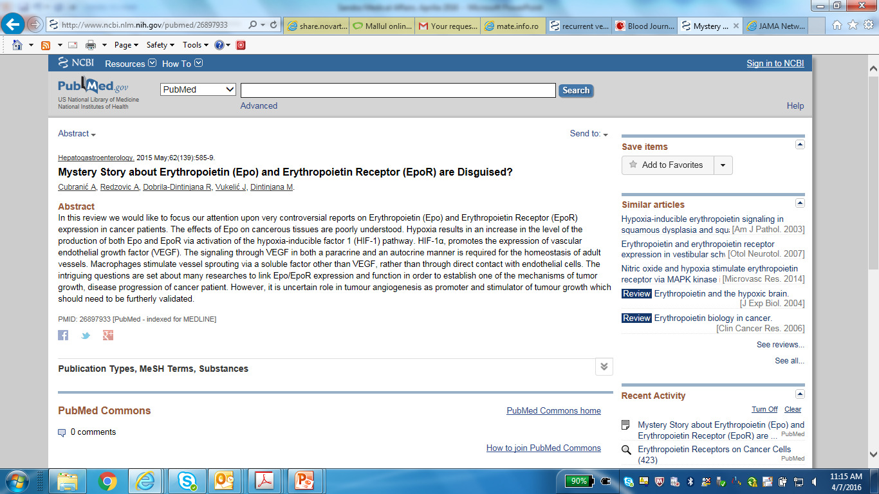
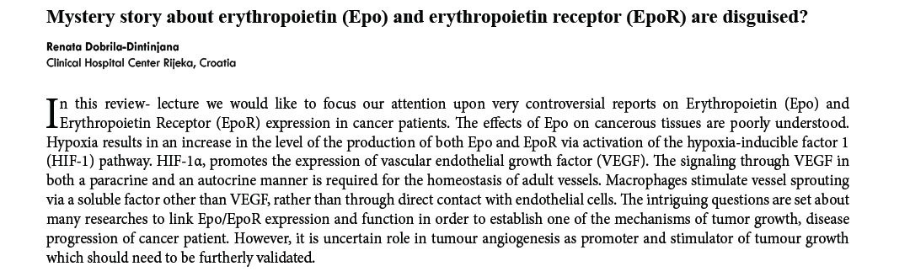
Notes:
Mystery Story about Erythropoietin (Epo) and Erythropoietin Receptor (EpoR) are Disguised?
Cubranić A, Redzovic A, Dobrila-Dintinjana R, Vukelić J, Dintinjana M.
Abstract
In this review we would like to focus our attention upon very controversial reports on Erythropoietin (Epo) and Erythropoietin Receptor (EpoR) expression in cancer patients. The effects of Epo on cancerous tissues are poorly understood. Hypoxia results in an increase in the level of the production of both Epo and EpoR via activation of the hypoxia-inducible factor 1 (HIF-1) pathway. HIF-1α, promotes the expression of vascular endothelial growth factor (VEGF). The signaling through VEGF in both a paracrine and an autocrine manner is required for the homeostasis of adult vessels. Macrophages stimulate vessel sprouting via a soluble factor other than VEGF, rather than through direct contact with endothelial cells. The intriguing questions are set about many researches to link Epo/EpoR expression and function in order to establish one of the mechanisms of tumor growth, disease progression of cancer patient. However, it is uncertain role in tumour angiogenesis as promoter and stimulator of tumour growth which should need to be furtherly validated.

Slide 24
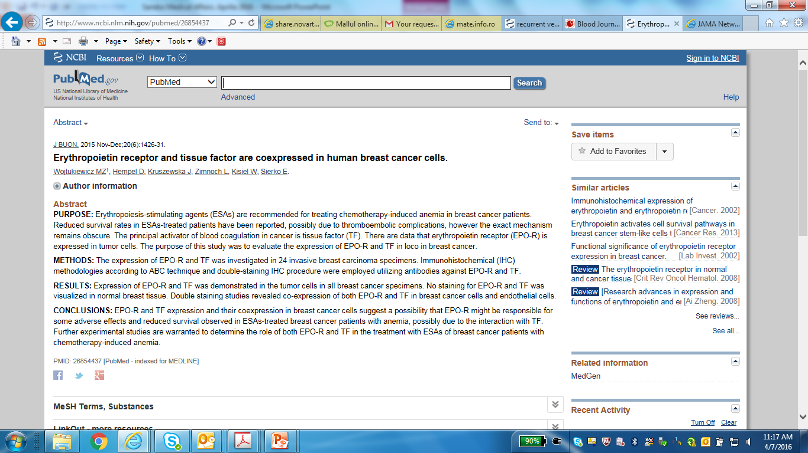
Notes:
Vasele intervin in hemostaza prin:
- vasoconstrictie in cadrul hemostazei primare cu scaderea fluxului sanguin in zona
lezata
- endoteliul vascular care:
􀂌 sintetizeaza factorul von Willebrand (fvW) cu rol in aderarea trombocitelor (si
de carrier pentru factorul VIII al coagularii)
􀂌 sintetizeaza prostaciclinele (PG I2) cu efect antiagregant si vasodilatator
􀂌 elibereaza factorul tisular (FT) 􀂟 declansarea coagularii prin mecanism
extrinsec
J BUON. 2015 Nov-Dec;20(6):1426-31.
Erythropoietin receptor and tissue factor are coexpressed in human breast cancer cells.
Wojtukiewicz MZ1, Hempel D, Kruszewska J, Zimnoch L, Kisiel W, Sierko E.
Author information
Abstract
PURPOSE:
Erythropoiesis-stimulating agents (ESAs) are recommended for treating chemotherapy-induced anemia in breast cancer patients. Reduced survival rates in ESAs-treated patients have been reported, possibly due to thromboembolic complications, however the exact mechanism remains obscure. The principal activator of blood coagulation in cancer is tissue factor (TF). There are data that erythropoietin receptor (EPO-R) is expressed in tumor cells. The purpose of this study was to evaluate the expression of EPO-R and TF in loco in breast cancer.
METHODS:
The expression of EPO-R and TF was investigated in 24 invasive breast carcinoma specimens. Immunohistochemical (IHC) methodologies according to ABC technique and double-staining IHC procedure were employed utilizing antibodies against EPO-R and TF.
RESULTS:
Expression of EPO-R and TF was demonstrated in the tumor cells in all breast cancer specimens. No staining for EPO-R and TF was visualized in normal breast tissue. Double staining studies revealed co-expression of both EPO-R and TF in breast cancer cells and endothelial cells.
CONCLUSIONS:
EPO-R and TF expression and their coexpression in breast cancer cells suggest a possibility that EPO-R might be responsible for some adverse effects and reduced survival observed in ESAs-treated breast cancer patients with anemia, possibly due to the interaction with TF. Further experimental studies are warranted to determine the role of both EPO-R and TF in the treatment with ESAs of breast cancer patients with chemotherapy-induced anemia.

Slide 25
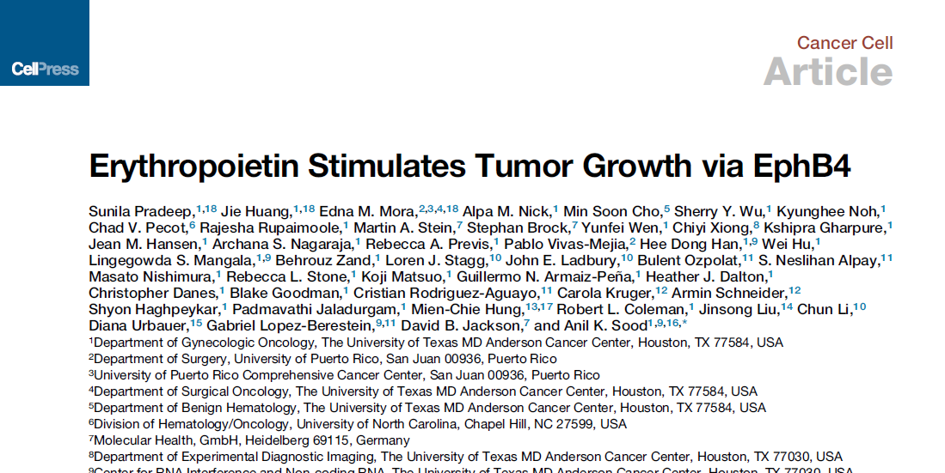
Notes:
Pharmacological doses of cEpo
have neuroprotective effects that have been shown to be independent
of EpoR function (Sturm et al., 2010). Epo has been
shown to prevent chemotherapy-induced neurotoxicity in cancer
patients (Kassem and Yassin, 2010). Administration of Epo
after a stroke can reduce the extent of damage and accelerate
patient recovery (Chang et al., 2005; Noguchi et al., 2007).

Slide 26
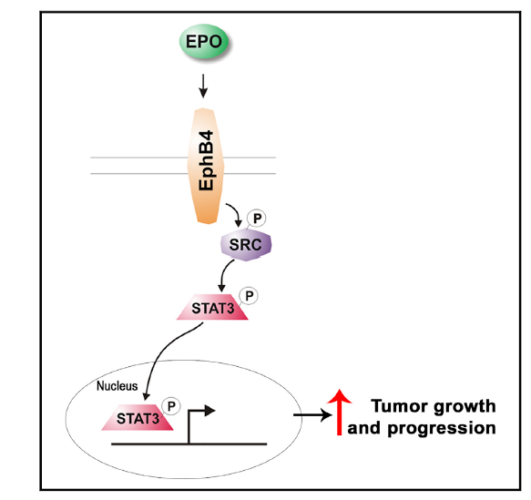
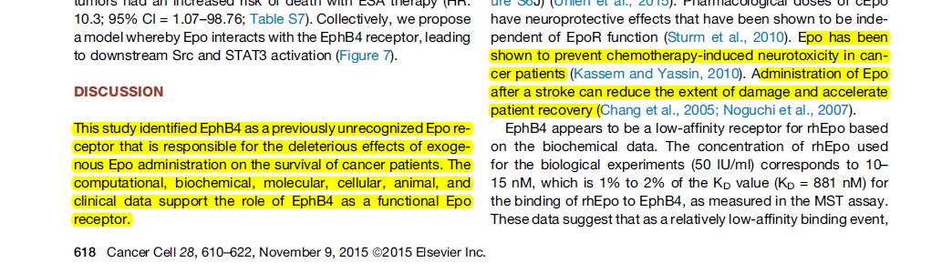

Slide 27
Riscul de recurenta trombotica sub tratamentul cu epoetine,
Prezenta receptorilor de eritropoetina pe celulele canceroase,
Riscul de progresie a bolii neoplazice in caz de administrare de epoetine,
Gestionarea anemiei la un pacient oncologic care asociaza si patologie cardiaca semnificativa (daca sunt stabilite doze maxime/minime de epoetine care pot fi folosite la acesti pacienti),
Asocierea la tratamentul cu epoetine a unor doze reduse de factori de crestere granulocitari, care ar potenta efectul si raspunsul epoetinelor.

Slide 28
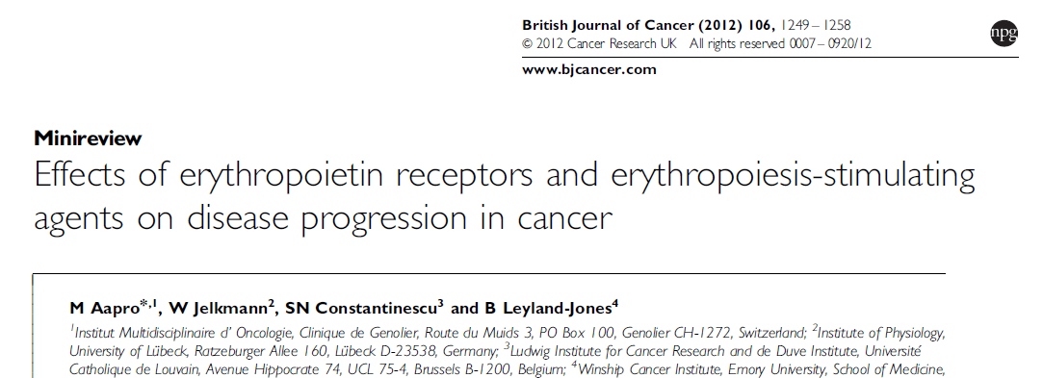

Slide 29
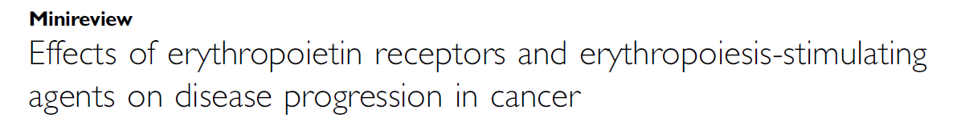
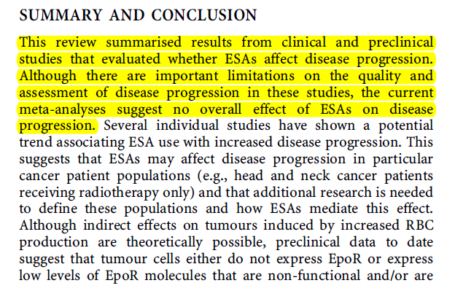

Slide 30
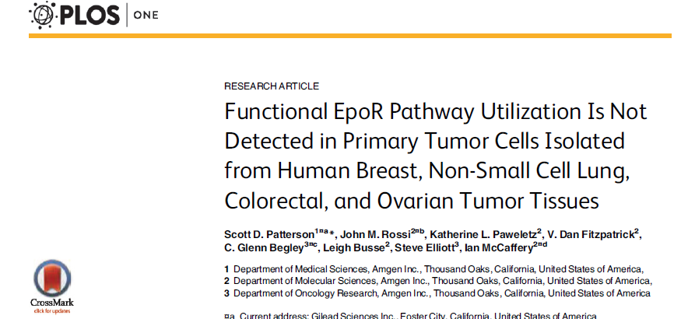
PLoS One. 2015 Mar 25;10(3):e0122149.

Slide 31
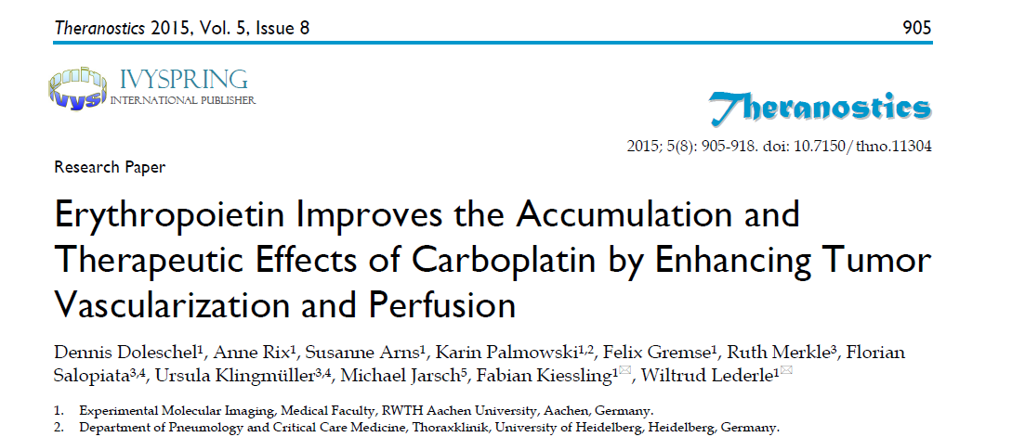
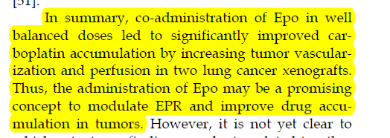
Notes:
However, tumor accumulation of nanoparticles depends on both, the size of the nanoparticles and the enhanced permeability and retention
(EPR) -effect of the tumor.

Slide 32
Riscul de recurenta trombotica sub tratamentul cu epoetine,
Prezenta receptorilor de eritropoetina pe celulele canceroase,
Riscul de progresie a bolii neoplazice in caz de administrare de epoetine,
Gestionarea anemiei la un pacient oncologic care asociaza si patologie cardiaca semnificativa (daca sunt stabilite doze maxime/minime de epoetine care pot fi folosite la acesti pacienti),
Asocierea la tratamentul cu epoetine a unor doze reduse de factori de crestere granulocitari, care ar potenta efectul si raspunsul epoetinelor.

Slide 33

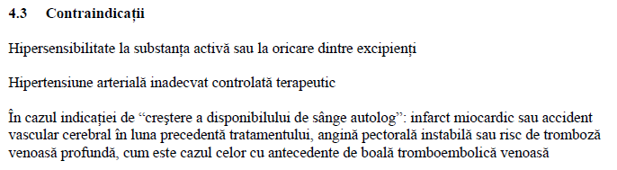

Slide 34
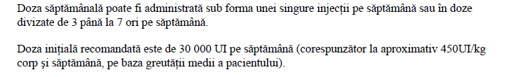
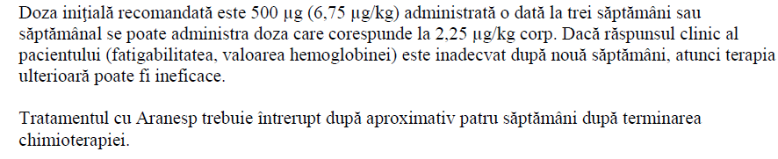
EPOETIN ALFA
EPOETIN BETA
DARBEPOETIN

Slide 35
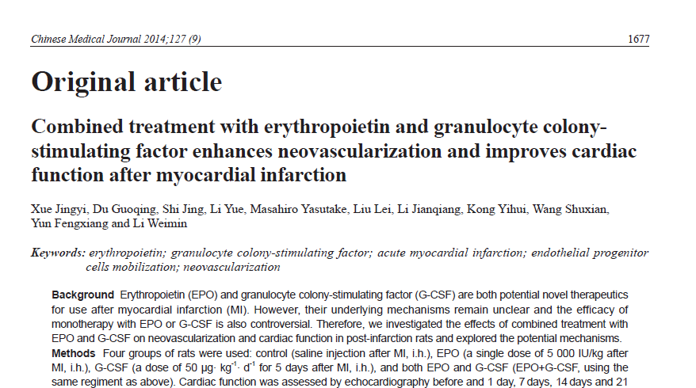

Slide 36
Riscul de recurenta trombotica sub tratamentul cu epoetine,
Prezenta receptorilor de eritropoetina pe celulele canceroase,
Riscul de progresie a bolii neoplazice in caz de administrare de epoetine,
Gestionarea anemiei la un pacient oncologic care asociaza si patologie cardiaca semnificativa (daca sunt stabilite doze maxime/minime de epoetine care pot fi folosite la acesti pacienti),
Asocierea la tratamentul cu epoetine a unor doze reduse de factori de crestere granulocitari, care ar potenta efectul si raspunsul epoetinelor.

Slide 37
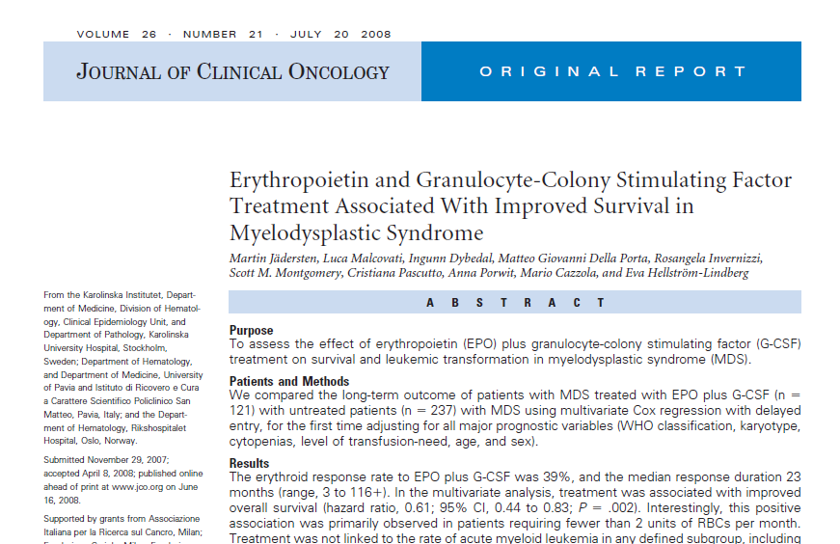

Slide 38
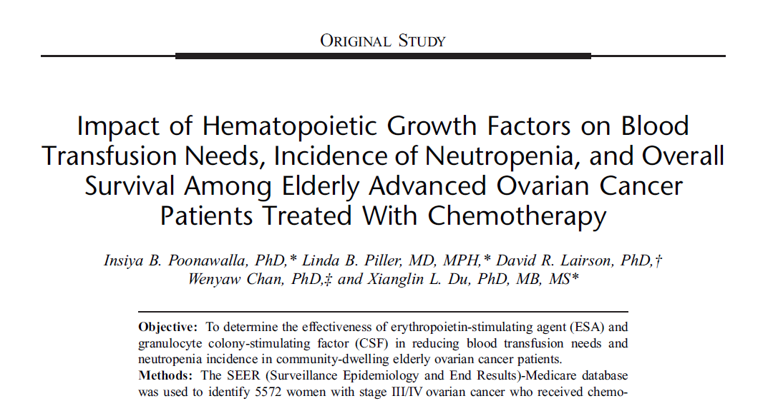

Slide 39
METHODS
Data Source, Study Design, and Study Population
Retrospective cohort study used the SEER (Surveillance, Epidemiology and End Results)-Medicare linked database.
5572 women aged ≥ 65 years who were diagnosed as having advanced-stage III/IV epithelial ovarian cancer between January 1, 2000, and December 31, 2009 (N = 8188).
For assessing the effect of HGF use on overall survival, patients were grouped into 4 categories:
ESA only,
CSF only,
ESA + CSF,
neither ESA nor CSF.

Slide 40
RESULTS
The mean age at diagnosis was 75 years, and a majority of the study population was white (92%).
Most women were diagnosed as having stage III (49%), serous histology (56%), and poorly or undifferentiated grade (52%) tumor.
Overall, 67%(n = 3718) received HGF supportive treatment, whereas 33% (n = 1854) did not receive any form of HGF.
In particular, 30% (n = 1662) received ESA + CSF, 24%(n = 1313) received ESA only, and 13% (n = 743) received CSF only.

Slide 41
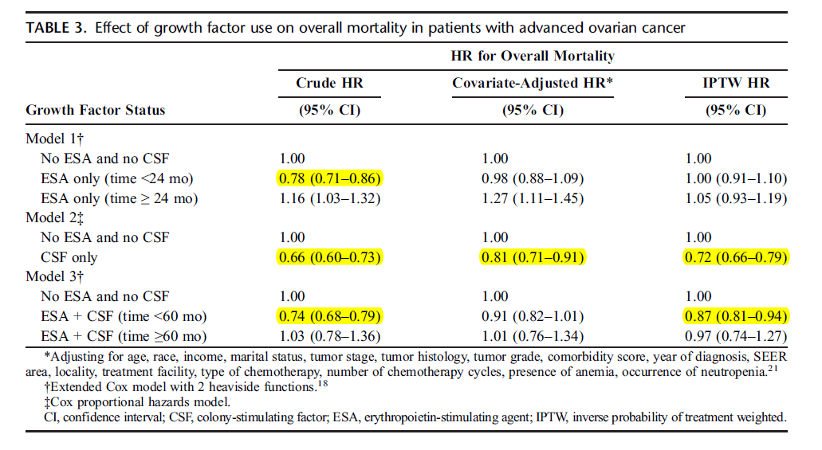

Slide 42
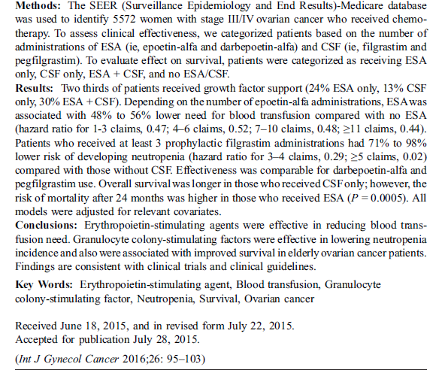

Slide 43
CONCLUZII

Slide 44

Riscul de recurenta trombotica sub tratamentul cu epoetine,
Prezenta receptorilor de eritropoetina pe celulele canceroase,
Riscul de progresie a bolii neoplazice in caz de administrare de epoetine,
Gestionarea anemiei la un pacient oncologic care asociaza si patologie cardiaca semnificativa (daca sunt stabilite doze maxime/minime de epoetine care pot fi folosite la acesti pacienti),
Asocierea la tratamentul cu epoetine a unor doze reduse de factori de crestere granulocitari, care ar potenta efectul si raspunsul epoetinelor.

Slide 45
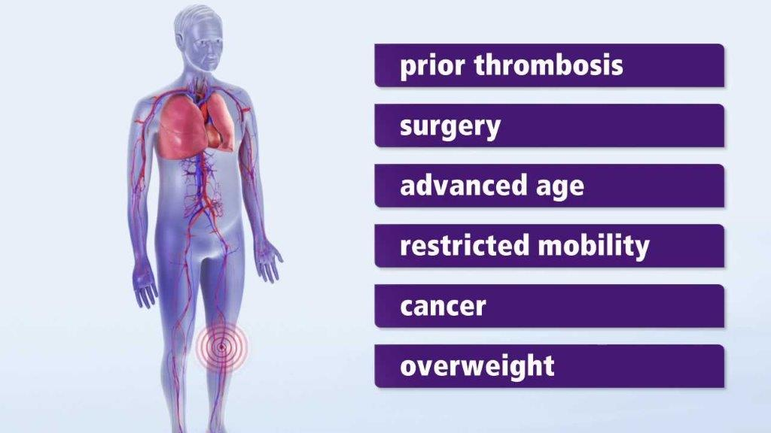
Riscul de recurenta trombotica sub tratamentul cu epoetine,
  Absenta informatiilor referitoare la riscul de recurenta trombotica sub tratamentul cu epoetine.

Slide 46
Riscul de recurenta trombotica sub tratamentul cu epoetine,
Prezenta receptorilor de eritropoetina pe celulele canceroase,
Riscul de progresie a bolii neoplazice in caz de administrare de epoetine,
Gestionarea anemiei la un pacient oncologic care asociaza si patologie cardiaca semnificativa (daca sunt stabilite doze maxime/minime de epoetine care pot fi folosite la acesti pacienti),
Asocierea la tratamentul cu epoetine a unor doze reduse de factori de crestere granulocitari, care ar potenta efectul si raspunsul epoetinelor.

Slide 47
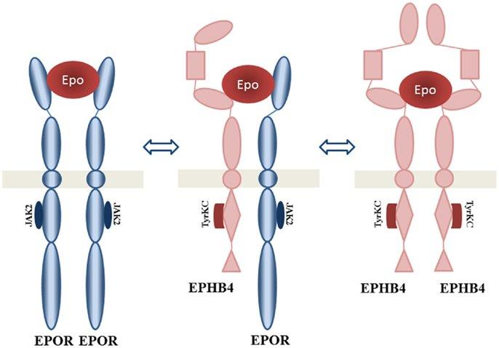
Riscul de recurenta trombotica sub tratamentul cu epoetine,
Prezenta receptorilor de eritropoetina pe celulele canceroase,
  Existenta receptorilor de eritropetina pe celulele tumorale.
  Cercetarile referitoare la receptorii de eritropoetina – ongoing.
  Descoperirea/cunoasterea/intelegerea lor – beneficii ulterioare.

Slide 48
Riscul de recurenta trombotica sub tratamentul cu epoetine,
Prezenta receptorilor de eritropoetina pe celulele canceroase,
Riscul de progresie a bolii neoplazice in caz de administrare de epoetine,
Gestionarea anemiei la un pacient oncologic care asociaza si patologie cardiaca semnificativa (daca sunt stabilite doze maxime/minime de epoetine care pot fi folosite la acesti pacienti),
Asocierea la tratamentul cu epoetine a unor doze reduse de factori de crestere granulocitari, care ar potenta efectul si raspunsul epoetinelor.

Slide 49
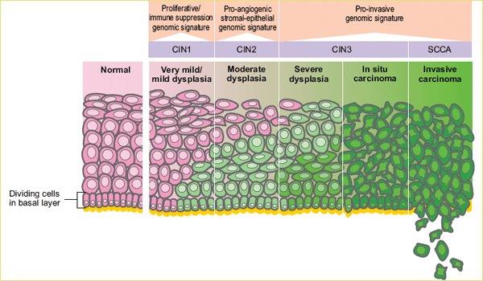
Riscul de recurenta trombotica sub tratamentul cu epoetine,
Prezenta receptorilor de eritropoetina pe celulele canceroase,
Riscul de progresie a bolii neoplazice in caz de administrare de epoetine,
  ?

Slide 50
Riscul de recurenta trombotica sub tratamentul cu epoetine,
Prezenta receptorilor de eritropoetina pe celulele canceroase,
Riscul de progresie a bolii neoplazice in caz de administrare de epoetine,
Gestionarea anemiei la un pacient oncologic care asociaza si patologie cardiaca semnificativa (daca sunt stabilite doze maxime/minime de epoetine care pot fi folosite la acesti pacienti),
Asocierea la tratamentul cu epoetine a unor doze reduse de factori de crestere granulocitari, care ar potenta efectul si raspunsul epoetinelor.

Slide 51
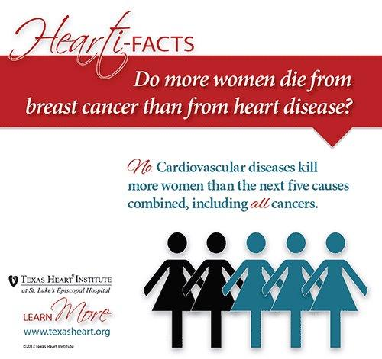
Riscul de recurenta trombotica sub tratamentul cu epoetine,
Prezenta receptorilor de eritropoetina pe celulele canceroase,
Riscul de progresie a bolii neoplazice in caz de administrare de epoetine,
Gestionarea anemiei la un pacient oncologic care asociaza si patologie cardiaca semnificativa (daca sunt stabilite doze maxime/minime de epoetine care pot fi folosite la acesti pacienti),
  CI – HTA necontrolata
  nu exista alte limitari
  studii recente in vitro prezinta beneficiul ESAs in IMA

Slide 52
Riscul de recurenta trombotica sub tratamentul cu epoetine,
Prezenta receptorilor de eritropoetina pe celulele canceroase,
Riscul de progresie a bolii neoplazice in caz de administrare de epoetine,
Gestionarea anemiei la un pacient oncologic care asociaza si patologie cardiaca semnificativa (daca sunt stabilite doze maxime/minime de epoetine care pot fi folosite la acesti pacienti),
Asocierea la tratamentul cu epoetine a unor doze reduse de factori de crestere granulocitari, care ar potenta efectul si raspunsul epoetinelor.

Slide 53
Riscul de recurenta trombotica sub tratamentul cu epoetine,
Prezenta receptorilor de eritropoetina pe celulele canceroase,
Riscul de progresie a bolii neoplazice in caz de administrare de epoetine,
Gestionarea anemiei la un pacient oncologic care asociaza si patologie cardiaca semnificativa (daca sunt stabilite doze maxime/minime de epoetine care pot fi folosite la acesti pacienti),
Asocierea la tratamentul cu epoetine a unor doze reduse de factori de crestere granulocitari, care ar potenta efectul si raspunsul epoetinelor.
  Eficacitate crescuta in sindroamele mielodisplazice

Slide 54
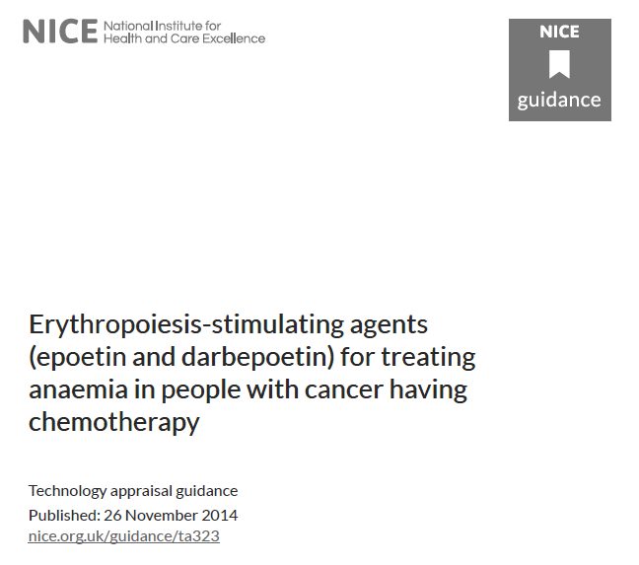

Slide 55
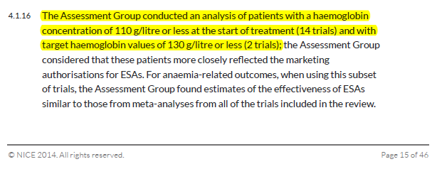
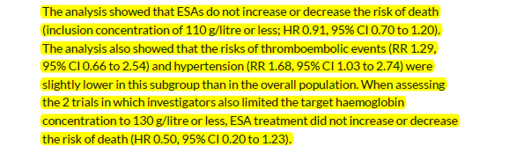
KEY POINTS
• In their previous appraisal (published in 2008), NICE recommended ESAs only for the treatment of platinum chemotherapy-induced anaemia in patients with ovarian cancer.
In the latest guidance (Nov. 2014) ESAs are now recommended, within their marketing authorisations (i.e. Hb level of 10–12 g/dL as the treatment target), for the treatment of chemotherapy-induced anaemia across all tumour types.
• As part of their reappraisal, NICE evaluated the latest Cochrane meta-analysis and extracted those studies in which ESAs were used in a manner that was closest to the current label. In this analysis, the impact on survival slightly favoured ESA use (HR 0.97), although NICE does note that the studies examined were not designed (i.e. under-powered) to assess survival as an outcome. Importantly, NICE does not take the view that ESAs are associated with a negative survival outcome.

Slide 56
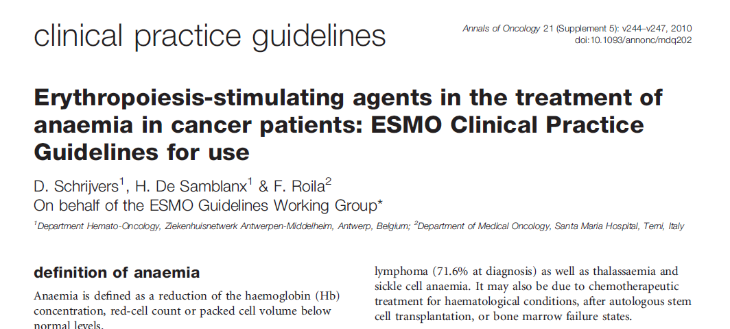

Slide 57
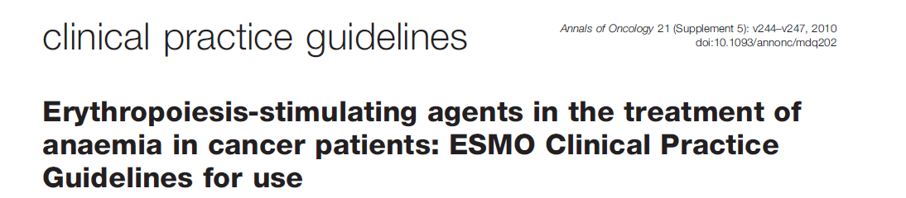
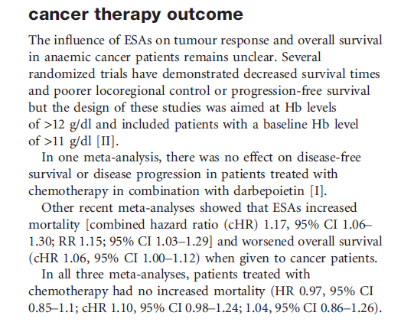

Slide 58
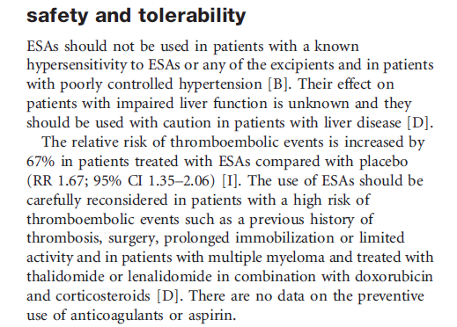

Slide 59
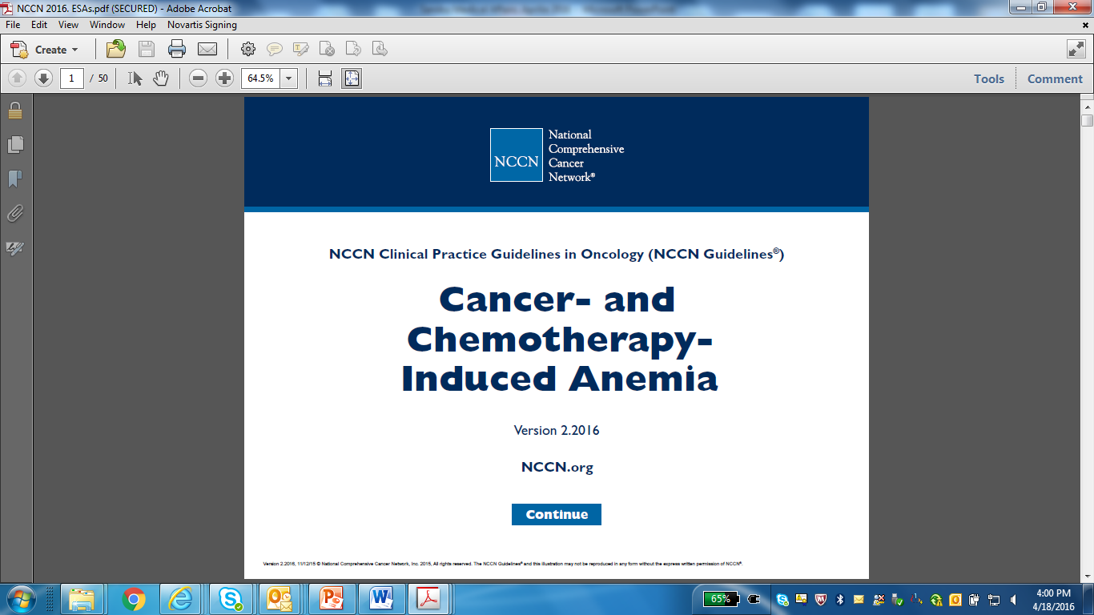

Slide 60
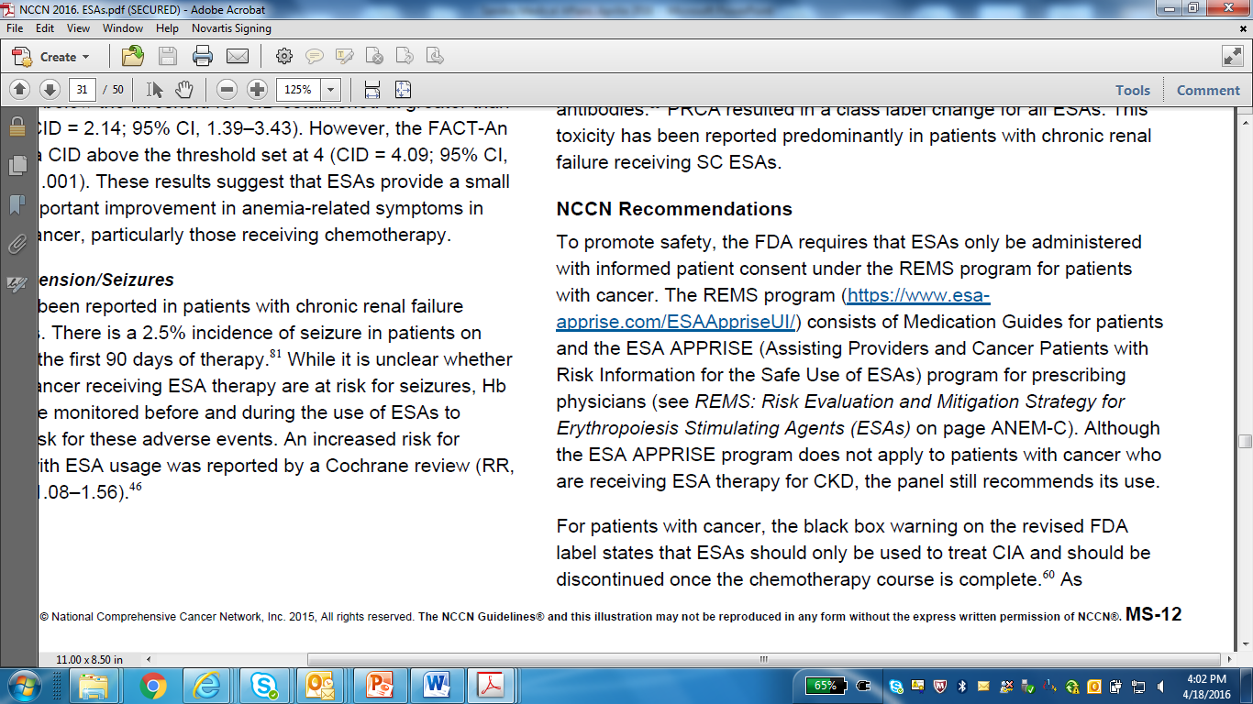
Notes:
Risk Evaluation and Mitigation Strategy (REMS)

Slide 61
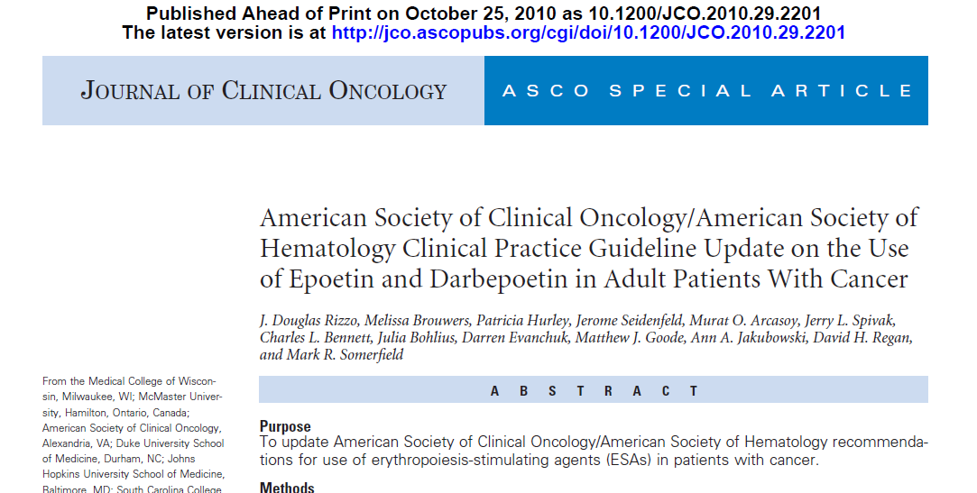

Slide 62
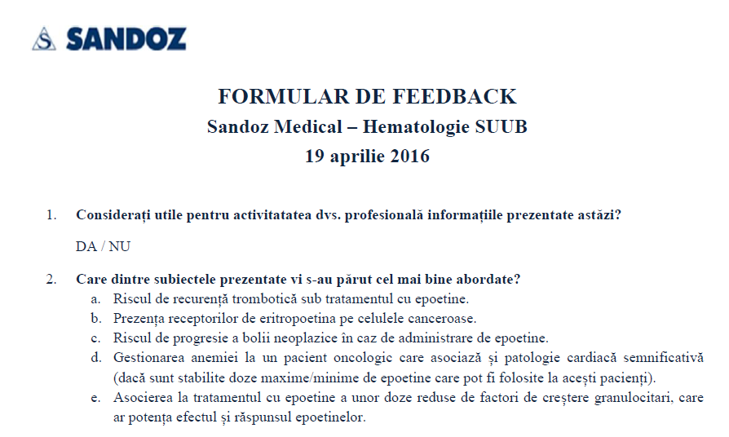


Slide 63

Multumesc
Sandoz Pharma Services S.R.L.
Calea Floreasca nr.169A, Cladirea A, etaj 1
Sector 1, Bucuresti, Romania
Telefon: 021.407.5160; Fax: 021.407.5161
e-mail: pv.ro@sandoz.com, medical.ro@sandoz.com
http://www.sandoz.com
MIHAELA LAZAR
0737730162
mihaela.lazar@sandoz.com; medical.ro@sandoz.com

