Slide 1
N-I-H
MIHAELA LAZAR, Medical Manager
Hematologie, SUUB, 22 martie 2016
Notes:
N-I-H (News in Hematology)

Slide 2

PROPUNERE PROIECT
Obiectiv: Prezentare informatii stiintifice noi/interes, utile in practica clinica din Sectia Hematologie a SUUB si/sau pentru dezvoltarea profesionala.
Selectia informatiilor:
Subiecte de interes (F2F, emails): patologie, ghiduri terapeutice, molecule, investigatii, etc.
Reviste medicale internationale (hematologie)/sites (ex. PubMed)
Prezentare 20-30’ (SDZ / SDZ-Hematologie SUUB)
Discutii 30’
Feedback.
mihaela.lazar@sandoz.com / medical.ro@sandoz.com

Slide 3
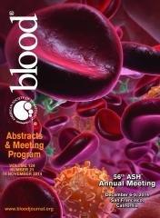
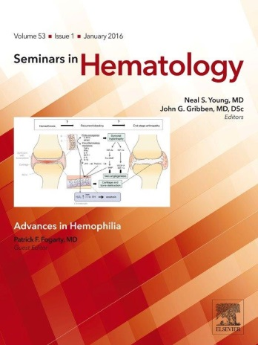
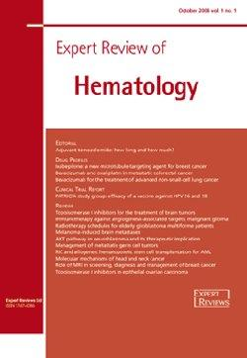

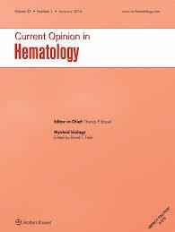
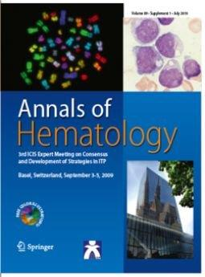
Blood
Seminars in Hematology
Annals of Hematology
Current opinion in Hematology
International Journal of Hematology
Therapeutic Advances in Hematology
British Journal of Hematology
Expert review of Hematology
etc.

Slide 4




http://www.cochranelibrary.com/
http://www.ncbi.nlm.nih.gov/pubmed
http://hm.cochrane.org/welcome-website-cochrane-haematological-malignancies
http://www.knowledge.scot.nhs.uk/home.aspx

Slide 5
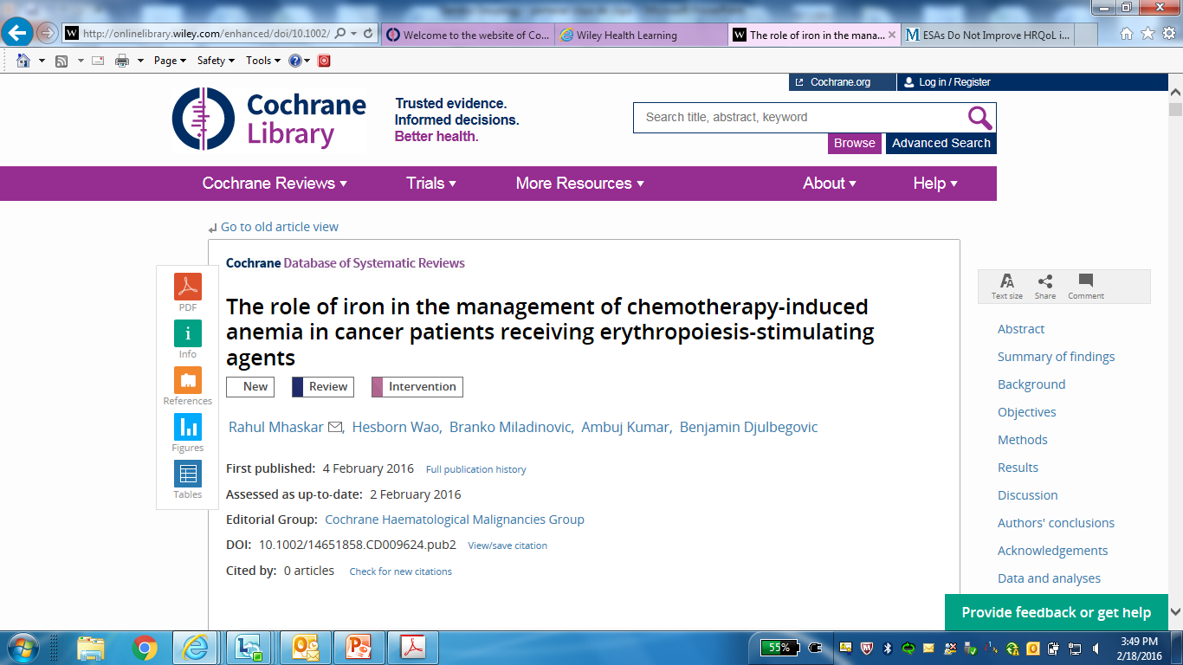

Slide 6
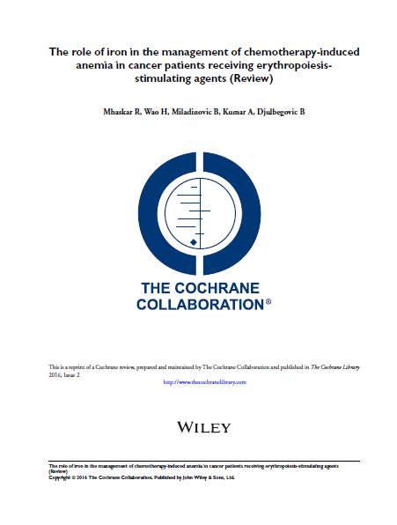
The role of iron in the management of
chemotherapy-induced
anemia in cancer patients receiving erythropoiesis stimulating agents
(Review)
http://onlinelibrary.wiley.com/enhanced/doi/10.1002/14651858.CD009624.pub2
Notes:
Majoritatea pacientilor cu cancer tratati cu chimioterapie dezvolta CIA.
~ 83% dintre pacienti tratati cu CT dezvolta CIA.
Majoritatea pacientilor cu CIA sufera de astenie, stare de slabiciune, dispnee → scaderea calitatii vietii si a statusului de performanta.
Obiectivul major al tratamentului in cazul pacientilor cu CIA este reducerea necesarului de trasnfuzii si maximizarea calitatii vietii.
Ghidurile NCCN si EORTC recomanda transfuziile de eritrocite ca o strategie eficienta de a trata CIA. Cu toate acestea, efectul transfuziilor este temporar si posibil asociat cu evenimente tromboembolice semnificative, precum si cu cresterea mortalitatii.
O alternativa la transfuziile de eritrocite in CIA este utilizarea ESAs.
ESAs cresc nivelurile de Hb, reduc necesarul de transfuzi si imbunatatesc calitatea vietii.
Cu toate acestea, si ESAs au aratat o incidenta mai mare a evenimentelor tromboembolice si cresterea mortalitatii (cu 10%).
Pacientii cu cancer care dezvolta CIA si care sunt tratati cu ESAs este foarte probabil sa experimenteze o crestere a necesarului de fier eritrocitar, care depaseste rezervele disponibile, avand ceea ce se numeste DEFICIT FUNCTIONAL DE FIER (FID = functional iron deficiency), cu producerea unor eritrocite sarace in fier la nivelul maduvei hematogene.
Co-administrarea de fier previne FID. Cu toate acestea, terapia cu fier nu este lipsita de neplaceri. Astfel, preparatele de fier administrate oral pot produce diaree/constipatie, inconfort stomacal, reactii alergice, etc. Cu toate acestea, preparatele de fier cu administrare intravenoasa se asociaza cu mai putine evenimente neplacute/adverse.
De-a lungul timpului au fost realizate cateva RTCs ca si-au propus sa evalueze eficacitatea asocierii fierului la ESAs vs. ESAs singuri pentru managementul CIA.
Cu toate acestea, evidentele referitoare la aceasta comparatie (Fe+ESAs vs ESAs) nu au fost pe deplin relevante. Unele studii au aratat ca asocierea de Fe iv la ESAs determina imbunatatirea raspunsului la ESAs, creste nivelul hb, raspuns hematopoietic mai mare, precum si imbunatatirea calitatii vietii pacientilor cu CIA. Alte studii arata ca Fe iv nu se asociaza cu modificari ale nivelurile Hb, transfuziilor sanguine si calitatii vietii pacientilor cu CIA.
Absenta unei evidente clare referitoare la beneficiile si riscurile asocierii Fierului la ESAs la pacientii cu CIA a fost punctul de plecare al acestei revizii sistematice.

Slide 7
The role of iron in the management of
chemotherapy-induced anemia in cancer patients receiving erythropoiesis stimulating agents (Review)
Background
Erythropoiesis-stimulating agents (ESAs) are commonly used to treat chemotherapy-induced anemia (CIA). However, about half of patients do not benefit.
Objectives
To evaluate the benefits and harms related to the use of iron as a supplement to ESA and iron alone compared with ESA alone in the management of CIA.
Search methods
Search for relevant trials from the Cochrane Central Register of Controlled Trials (CENTRAL) (issue 1 January 2016), MEDLINE (1950 to February 2016), and www.clinicaltrials.gov without using any language limits.
Selection criteria
All randomized controlled trials (RCTs) comparing ’iron plus ESA’ or ’iron alone’ versus ’ESA alone’ in people with CIA were eligible for inclusion.
Data collection and analysis
Used standard methodological procedures expected by Cochrane.

Slide 8
The role of iron in the management of
chemotherapy-induced anemia in cancer patients receiving erythropoiesis stimulating agents (Review)
PRIMARY OUTCOMES
Overall survival, defined as the time to death from any cause.
SECONDARY OUTCOMES
1. Hematopoietic response, defined as increasing Hb by ≥ 2 g/dL from baseline or increase to Hb 12 g/dL without transfusion.
2. RBC transfusions.
3. Time to hematopoietic response.
4. Mean change in Hb level from baseline.
5. Changes in quality of life.
6. Adverse events.
7. Treatment-related mortality.

Slide 9
The role of iron in the management of
chemotherapy-induced anemia in cancer patients receiving erythropoiesis stimulating agents (Review)
Main results
8 RCTs (12 comparisons) comparing ESA plus iron versus ESA alone enrolling 2087 participants.
No any trial comparing iron alone versus ESAs alone in people with CIA.
None of the included RCTs reported overall survival.

Slide 10
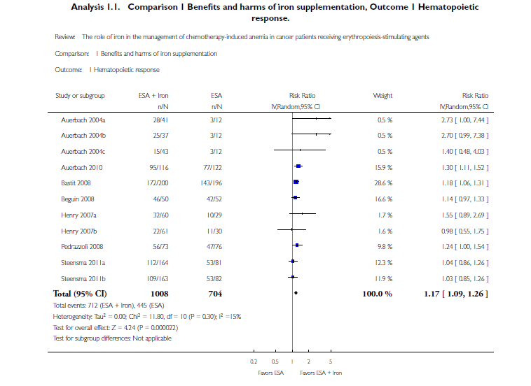
The role of iron in the management of
chemotherapy-induced anemia in cancer patients receiving erythropoiesis stimulating agents (Review)
Hematopoietic response
There was a beneficial effect of iron supplementation to ESAs compared with ESAs alone on hematopoietic response
(risk ratio (RR) 1.17, 95% confidence interval (CI) 1.09 to 1.26; P < 0.0001; 1712 participants; 11 comparisons; high-quality evidence).
Notes:
Hematopoietic response
We extracted data from seven studies (11 comparisons; 1712 participants).
Hematopoietic response rate was statistically significantly superior in participants receiving iron supplementation to ESAs than participants receiving ESAs alone in the management of CIA (risk ratio (RR) 1.17, 95% confidence interval (CI) 1.09 to 1.26; P < 0.0001) (Analysis 1.1). There was no heterogeneity
among these trials (I² = 15%, P = 0.30).

Slide 11
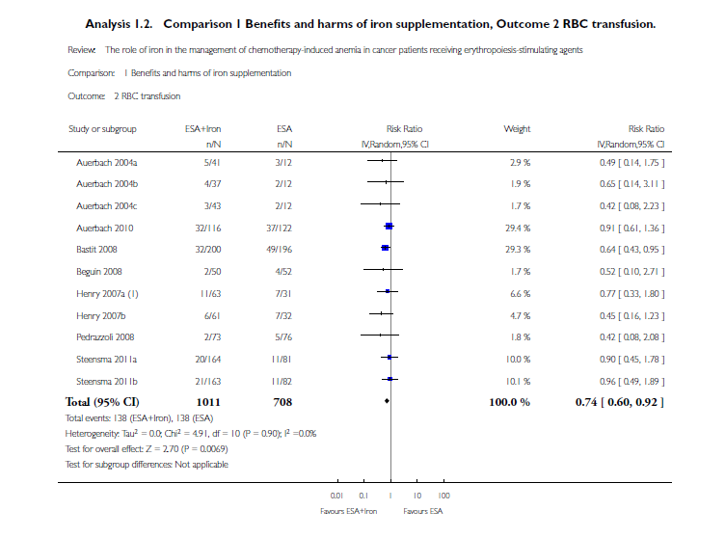
The role of iron in the management of
chemotherapy-induced anemia in cancer patients receiving erythropoiesis stimulating agents (Review)
RBC transfusions
Significantly fewer participants treated with iron supplementation
to ESAs required RBC transfusions compared to
participants treated with ESAs alone
(RR 0.74, 95% CI 0.60 to
0.92; P = 0.007)
Notes:
RBC transfusions
We extracted data from seven studies (11 comparisons; 1719 participants).
Significantly fewer participants treated with iron supplementation to ESAs required RBC transfusions compared to participants treated with ESAs alone (RR 0.74, 95% CI 0.60 to 0.92; P = 0.007) (Analysis 1.2).Therewas no heterogeneity among these trials (I² = 0%, P = 0.90).

Slide 12
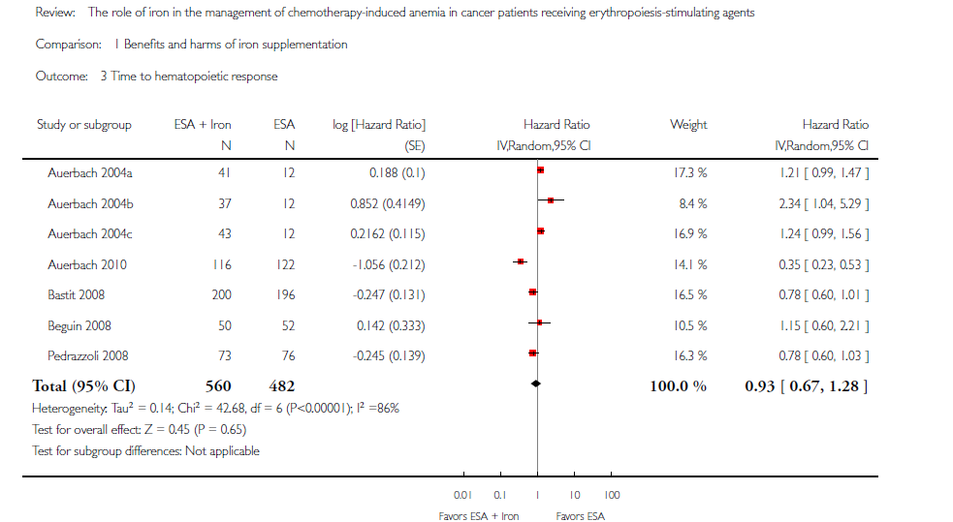
The role of iron in the management of
chemotherapy-induced anemia in cancer patients receiving erythropoiesis stimulating agents (Review)
Median time to hematopoietic response
No differences in the median time to hematopoietic response between participants receiving iron supplementation
to ESAs versus those who received ESAs alone
(HR 0.93, 95% CI 0.67 to 1.28;
P = 0.65)
Notes:
Mean change in Hb level
We extracted data fromthree studies (seven comparisons; 827 participants).
Hb level was statistically significantly superior in participants receiving iron supplementation to ESAs than in participants receiving ESAs alone in the management of CIA (mean difference (MD) 0.48, 95% CI 0.10 to 0.86; P = 0.01). There was substantial heterogeneity among these trials (I² =69%, P = 0.003).

Slide 13
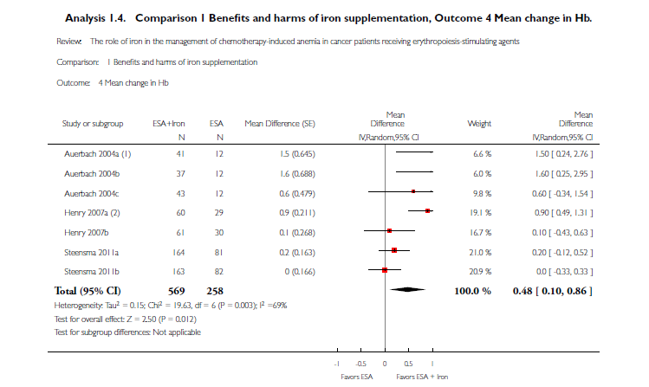
The role of iron in the management of
chemotherapy-induced anemia in cancer patients receiving erythropoiesis stimulating agents (Review)
Mean change in Hb level
Hb level was statistically significantly superior in participants
receiving iron supplementation to ESAs than in participants
receiving ESAs alone in the management of CIA
(mean difference (MD)
0.48, 95% CI 0.10 to 0.86; P = 0.01)
Notes:
Mean change in Hb level
We extracted data fromthree studies (seven comparisons; 827 participants).
Hb level was statistically significantly superior in participants receiving iron supplementation to ESAs than in participants receiving ESAs alone in the management of CIA (mean difference (MD) 0.48, 95% CI 0.10 to 0.86; P = 0.01). There was substantial heterogeneity among these trials (I² =69%, P = 0.003).

Slide 14
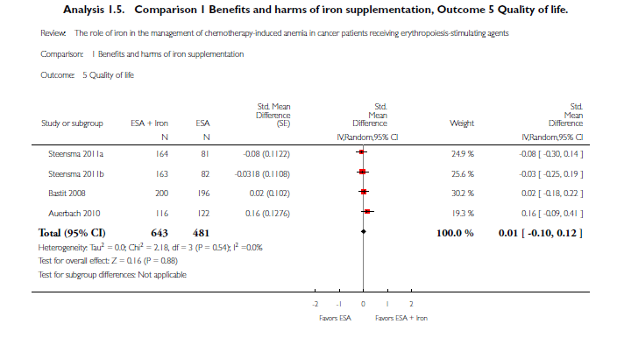
The role of iron in the management of
chemotherapy-induced anemia in cancer patients receiving erythropoiesis stimulating agents (Review)
Quality of life
There were no differences in terms of quality of life between participants receiving iron supplementation
to ESAs versus those who received ESAs alone
(standardized mean difference (SMD) 0.01, 95% CI -0.10 to 0.12; P = 0.88)
Notes:
Quality of life
Quality of life data were extractable from three studies (four comparisons; 1124 participants). We found no differences in terms of quality of life between participants receiving iron supplementation to ESAs versus those who received ESAs alone (standardized mean difference (SMD) 0.01, 95% CI -0.10 to 0.12; P = 0.88). There was no heterogeneity among these trials (I²= 0%, P = 0.54).

Slide 15
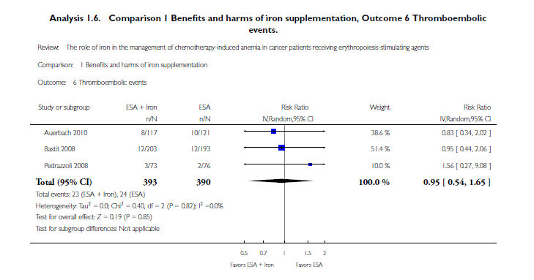
The role of iron in the management of
chemotherapy-induced anemia in cancer patients receiving erythropoiesis stimulating agents (Review)
Thromboembolic events
The incidence of thromboembolic events in participants
treated with iron supplementation to ESAs did not differ from that in participants treated with ESAs alone
(RR 0.95, 95% CI 0.54 to 1.65; P = 0.85).

Slide 16
The role of iron in the management of
chemotherapy-induced anemia in cancer patients receiving erythropoiesis stimulating agents (Review)
Route of iron administration
RCTs in which IV iron was
used showed statistically significant evidence for a difference with
iron supplementation versus ESAs alone (RR 1.20, 95% CI 1.10 to 1.31; P < 0.00001) compared with oral iron supplementation
(RR 1.04, 95% CI 0.87 to 1.24; P = 0.68) for the outcome of hematopoietic response.
However, the difference between the
subgroups was not statistically significant (test of interaction: P = 0.16)

Slide 17
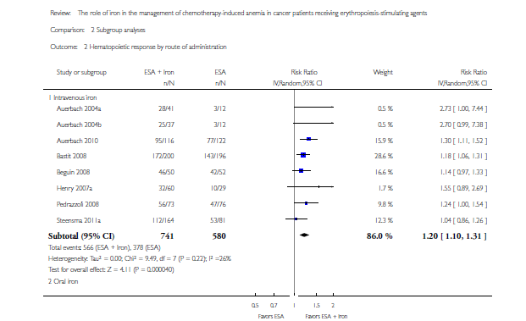
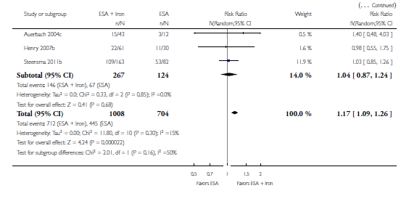
The role of iron in the management of
chemotherapy-induced anemia in cancer patients receiving erythropoiesis stimulating agents (Review)

Slide 18
The role of iron in the management of
chemotherapy-induced anemia in cancer patients receiving erythropoiesis stimulating agents (Review)
Authors’ conclusions
Addition of iron to ESAs offers:
superior hematopoietic response,
reduces the risk of RBC transfusions,
improves Hb levels,
appears to be well tolerated.
None of the included RCTs reported overall survival.
No evidence for a difference in quality of life with iron supplementation.

Slide 19
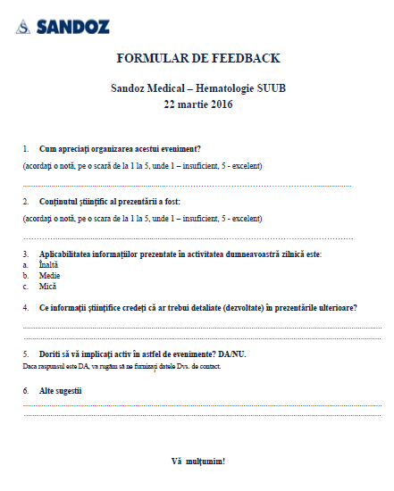
NEXT STEPS
1. Feedback.
2. Informatii stiintifice de interes.
3. Frecventa prezentarilor.

Slide 20

Multumesc
mihaela.lazar@sandoz.com
0737730162
Sandoz Pharma Services S.R.L.
Calea Floreasca nr.169A, Cladirea A, etaj 1
Sector 1, Bucuresti, Romania
Telefon: 021.407.5160; Fax: 021.407.5161
e-mail: pv.ro@sandoz.com, medical.ro@sandoz.com
http://www.sandoz.com

