Slide 1
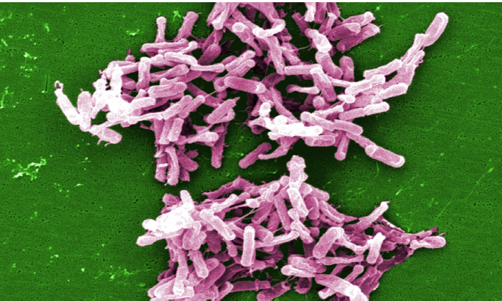
Infectia cu
Clostridium Difficile (ICD) la pacientii oncologici
Dr. Ana-Maria Craciun

Slide 2
Obiective
Cunoasterea microbiologiei si epidemiologiei ICD
Criterii de diagnostic
Recomandari terapeutice
Particularitati in tratamentul pacientului oncologic
Preventia ICD

Slide 3
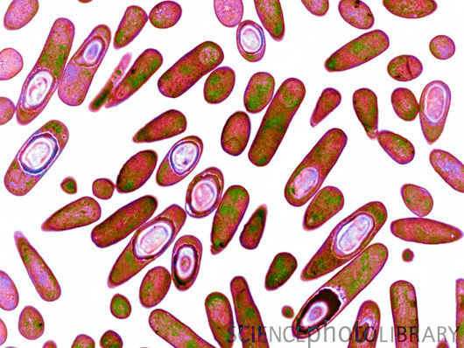
Microbiologie ICD
Bacil G+ ,anaerob, sporulat.
Colonizare intestinala 1-3% adulti sanatosi, 70% copii<12 luni
Producerea de toxine ( toxina A>toxina B)→→BDA
Doza infectanta < 10 spori
Singura bacterie nosocomiala anaeroba ce formeaza spori (supravietuieste > 5 luni, greu de distrus)
Prima cauza nosocomiala de BDA-asociata AB terapiei

Slide 4
Epidemiologie - etiologia BDA pe grupe de varsta in spitalele din Bucuresti
BDA spitalizata - Prevalenta etiologii pe grupe de varsta - Bucuresti, vara 2013
100%
90%
80%
70%
60%
% cazuri raportate
50%
Cl difficile Rotavirus Campylobacter E coli Patogen Salmonella Shigella
40%
30%
20%
10%
0%
< 1
1-4
5-9
Grupe varsta (ani)
10-14
15-64
65+
Raport de activitate/2013-DSP Bucuresti

Slide 5
Transmiterea ICD
Fecal-orala
    maini
    Suprafete
Rezervor: persoane colonizate/infectate, suprafete
Nosocomiala
Comunitara

Slide 6
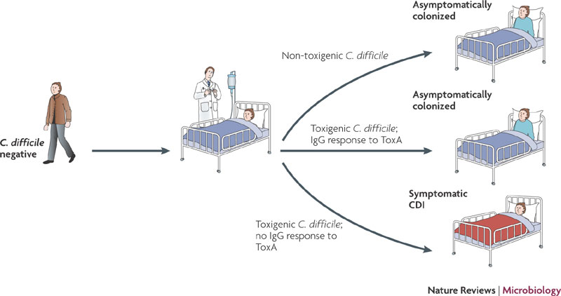
Transmiterea ICD

Slide 9
Patogenie CDI
Toxine A & B → leziuni +/- pseudomembrane
Pasul 3: AB terapie →flora comensala alterata
Pasul 2: transformarea in forma vegetativa
Pasul 1: Ingestia sporilor

Slide 10
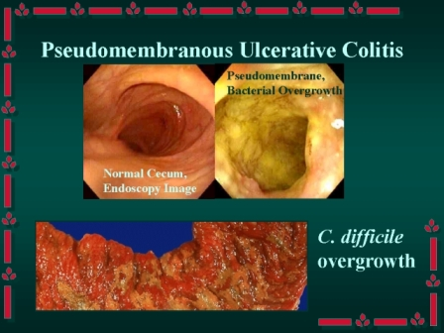
Patogenie CDI

Slide 11
Factori de risc CDI
AB-terapie
Spitalizare
Varsta ≥ 64 ani
Imunodeficienta
Chimioterapie
Chirurgie GI
SNG
antiacide

Slide 12
AB associate CDI
++++ | ++ | +
amoxicilina | sulfamide | tetraciclina
ampicilina | macrolide | rifampicina
cefalosporine | carbapeneme | aminoglicozide
fluoroquinolone | Alte peniciline | cloramfenicol
clindamicina

Slide 13
Diagnostic CDI
Cand este indicata testarea ?
Semne sugestive CDI + factori favorizanti
Severitatea CDI
Comorbiditati
Infectie nosocomiala/comunitara ?

Slide 14
Recomandari terapeutice
Izolarea pacientului
Solutii antiseptic cloramina
Inlaturarea factorilor precipitanti in masura posibilitatilor (AB, antiacide)
Severitate redusa/moderata-metronidazole 500 x 3/zi → + vancomicina 125 mg x 4/zi po dc. simptomatologia persista dupa 7 zile
Severitate crescuta-vancomicna 125 mg x 4/zi →simptomatologia persista la 7 zile → ↗ dozei 250-500 mg x 4/zi +/- Metronidazol sau Tygacil +/- clisme cu vancomicina (terapie de salvare)
Colectomie, TMF
Probiotic-controversat-bacteriemie Lactobacillus la pacientii imunodeprimati (neutropenie, HIV)

Slide 15
Alternative - Fidaxomicin
Non-inferioritate vancomicina - dpdv curativ
Recurente mai putine comparative cu vancomicina
Fidaxomicin versus Vancomycin for Clostridium difficile Infection
  Thomas J. Louie, et.all, N Engl J Med 2011
  http://www.nejm.org/doi/full/10.1056/NEJMoa0910812

Slide 16
Alternative - imunoglobuline
B 77 ani, CDI + BDA - terapie escaladata vancomicina + metronidazole fara atenuarea simptomatologiei dupa 25 de zile → IGIV 400 mg/ Kgc/12 ore → remiterea simptomatologie, fara recurenta.
Intravenous Immunoglobulin in the Treatment of Severe Clostridium Difficile Colitis
Nihae Shah et. all, J Glob Infect Dis. 2014 Apr-Jun; 6(2): 82–85.
http://www.ncbi.nlm.nih.gov/pmc/articles/PMC4049046/

Slide 17
Tratamentul recidivelor
Vancomicina +/- Metronidazol
Terapie dezescaladata Vancomicina - la a 2-a recidiva
  125 mg la fiecare 6 ore, 10-14 zile
  apoi 125 mg la fiecare 12 ore, 7 zile
  apoi 125 mg zilnic, 7 zile
  125 mg la fiecare 2-3 zile

Slide 18
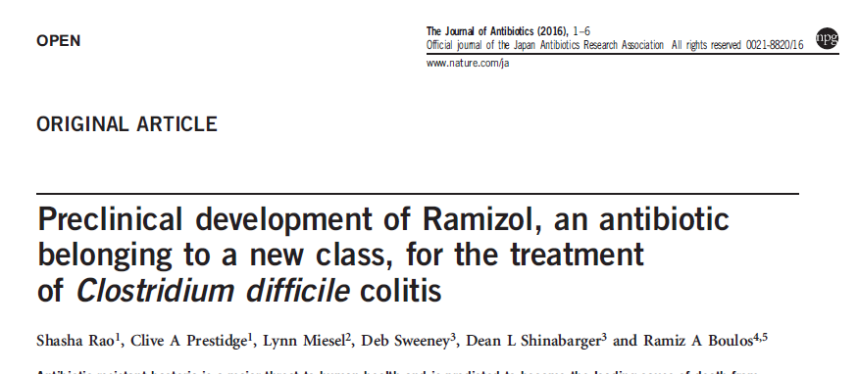
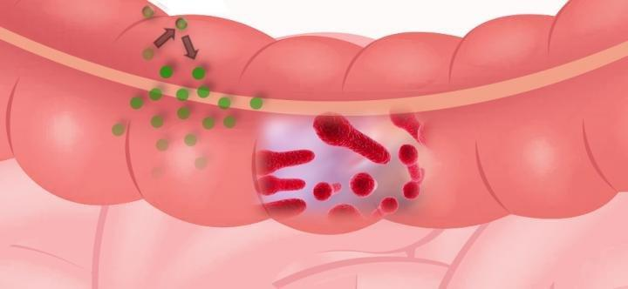
Perspective
RAMIZOL
Preclinical development of Ramizol, an antibiotic belonging to a new class, for the treatment of Clostridium difficile colitis
Shasha Rao et all., The Journal of Antibiotics advance online publication 18 May 2016
http://www.nature.com/ja/journal/vaop/ncurrent/full/ja201645a.html
Notes:
A scientific paper released today in the Journal of Antibiotics presents the pre-clinical development of Ramizol®, a first generation drug belonging to a new class of styrylbenzene antibiotics with a novel mechanism of action.
The research was undertaken by Australian company Boulos & Cooper Pharmaceuticals in partnership with the University of South Australia, Flinders University, Eurofins Panlabs and Micromyx LLC. The study found that over 99.9% of the drug, administered orally, stays in the gastrointestinal tract where it can reach the bacteria in the colon at high enough concentrations to yield a therapeutic effect.
Chief Executive Officer of Boulos & Cooper Pharmaceuticals, Dr Ramiz Boulos, said "this new class of antibiotics has antioxidant properties and can be manufactured for a low cost; benefits that will be felt by the end-user".
The new antibiotic has low frequency of resistance and shows promise as a monotherapy for the treatment of Clostridium difficile associated disease. Dr Boulos stated "we are very excited about these results given the unforgiving nature of Clostridium difficile infections". He added "In a world where there are few treatment options, we are desperate for new antibiotics to fight intractable infections".
The company expects to start Phase I clinical trials in 2017.

Slide 19
Prezentare caz
B, 45 ani
Dg: LAM-panmieloza acuta cu mielofibroza (WHO) – dg iulie 2013, Sdr Febril, anemie si trombocitopenie secundare
Internare Hematologie SUUB-23.08-26.09 (35 zile)
Internare anterioara Sp. Victor Babes

Slide 20
24-28.08 | 28.08: L 1300/mmc, Hgb 7, Plt 46.000/mmc |  | CT “5+2” AB + antimicotic ( Cilopen, Gentamicina, Metronidazol, Voriconazol)
2.09 | L 700/mmc Tox A&B Cl.Diff +, bioch N CT abd-edem parietal cadru colic, lichid de ascita 35 mm | Dureri abdominale +++, initial FID→generalizate, febra, scaune diareice ( >3/zi) | Suplimentare Vancomicina 250 mg la 6 ore
15.09 | L 2000/mmc, Hgb 9 g/dl, Plt 56.000/mmc, bioch/ coag N | Abdomen intens meteorizat, ascita, dureros difuz, 3-4 scaune diareice/zi | CH-abdomen acut ch, megacolon toxic?→ Colectomie totala cu ileostoma
15.09-19.09 | 19.09: L 3890/mmc, Hgb 8,5 g/dl, Plt 49.000/mmc, Bioch N | Evolutie clinica favorabila | ATI: tratament suportiv , Vancomicina 250 mg la 6 ore, Metronidazol 500 mg iv
21-26.09 | L 2.900---6.300/mmc, Hgb 9,4—9,7 g/dl, Plt 39.000—43.000/mmc, PCR ↗, PT 5,9 g/dl, ALB 3 g/dl 23.09 tox Cl Diff NEG | 21.09- t 38,7 grd C →→→ Hemocult + Stafilococ auriu MRSA Din 24.09-stare generala buna, afebrile, se remite simptomatologia ( fara scaune diareice) | Invanz 1 g/zi Linezolid Corectare hipoalbuminemie

Slide 21
Va multumesc !

